Slide 1
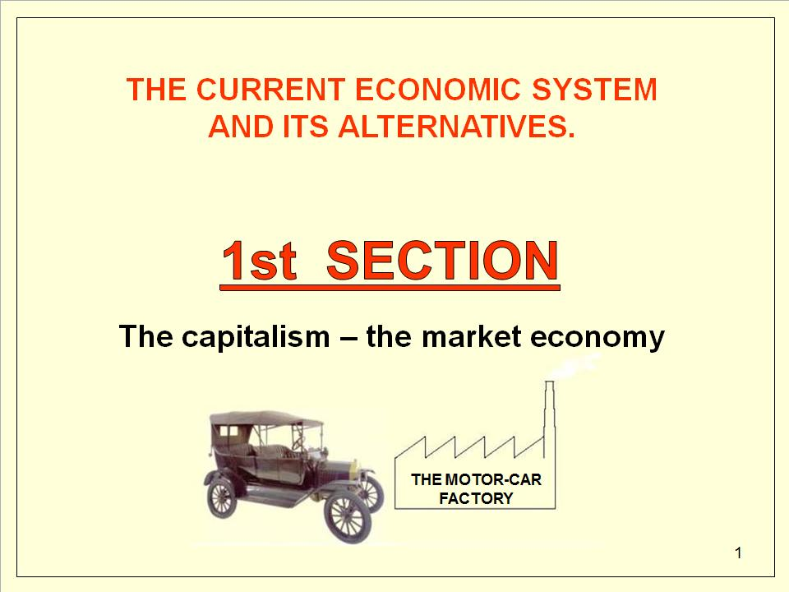
SECTION ONE
Capitalism - The market economy
Notes:
To prepare a conference read first comments like this one under the slides.
The presentation consists of three sections:
The metaphor of the motor-car industry (analysis of the capitalist system of a market economy)
The metaphor of the ravioli industry (analysis of the consequences of the system of market economy)
The metaphor of the nationalization of the ravioli factory (analysis of possible alternatives)
http://en.wikipedia.org/wiki/Market_economy

Slide 2
THE CURRENT ECONOMIC SYSTEM AND ITS ALTERNATIVES GENERAL LAYOUT (1st section, the automobile industry)
The capitalists start a business
Engaging the workforce
Production
Appropriation of surplus value
A rival business
Reduction of profits
Rationalisation, production, automatisation
Unemployed and the rich
Overproduction
Redundancies
Ceasing production and inward investment
Economic crisis
The State: measures to support the economy
counter-cyclical and monetary control measures
Nationalisation
military purchases and deployment
War, damage
Reconstruction
Notes:
.

Slide 3
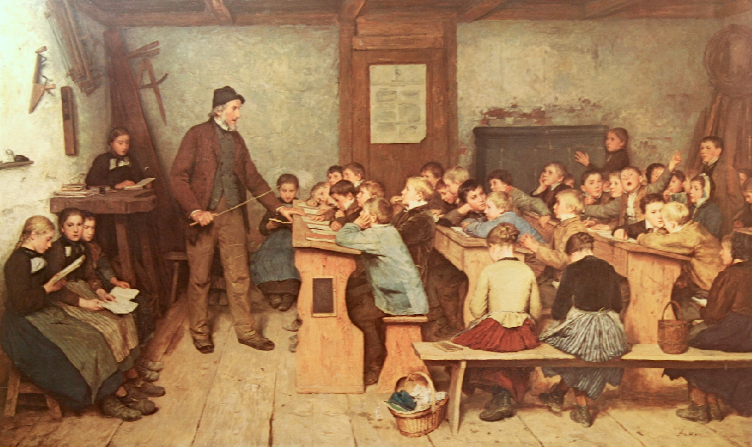

Classroom depiction 1848 (Anker)
"Education is the most powerful weapon which we can use to change the world" – Nelson Mandela
Notes:
The art of transmitting knowledge.
Note: 40 students in a small room.
Painted of Albert Anker: The school (1831 – 1910)
http://en.wikipedia.org/wiki/Albert_Anker?uselang=it

Slide 4
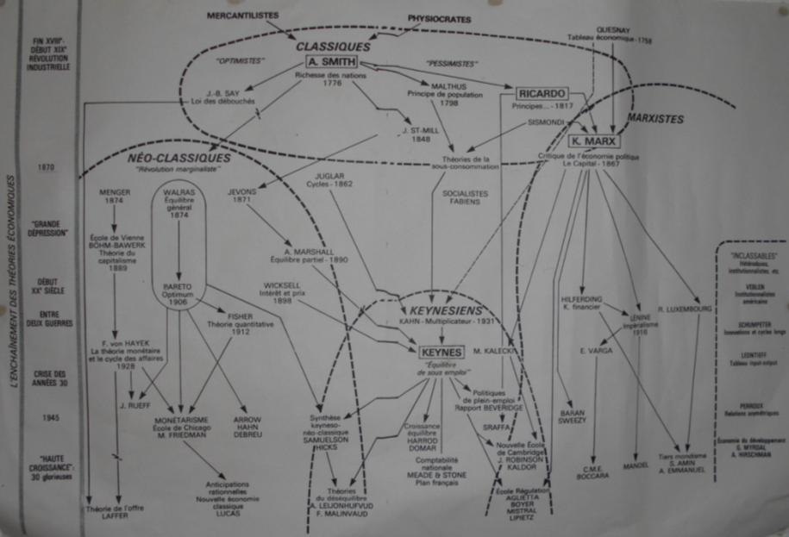
I. and II. int.
III. int.
IV. int.
Conservatives
Reformists
Revolutionaries
IMPORTANT SCHOOLS OF ECONOMIC THOUGHT
Notes:
The most important schools of economy
The neoclassical support the system of market economy that should regulate itself (Austrian and Chicago school).
Keynesians support the system of market economy, however, want to correct / reform it through targeted anticyclical interventions.
The Marxists want to change the market economy system in a planned economy system.
The fathers of economy Smith and Ricardo analyzed the economic system and proposed (at the beginning of the industrial revolution) some corrective measures and rules.
Following this line Keynes proposed counter-cyclical interventions and Friedman proposed a better control of the money supply.
Only Karl Marx (I. and II. International socialist organization) said that the economic system must be completely reformed. On this line, Lenin (III. International communist organization) analyzed the role of the state and provided his disappearance. Mandel (IV. International communist revolutionary organization) called for the continuous revolution.
Today the right-wing parties, under the pretext of the freedom, advocate a substantial reduction of the state with its public and social services and its task of redistributing the richness (considered an unbearable cost). This solution would lead to an impoverishment of the middle and lower classes and further enrichment of the bourgeoisie.
http://en.wikipedia.org/wiki/Second_International
http://en.wikipedia.org/wiki/Third_International
http://en.wikipedia.org/wiki/Fourth_International
http://en.wikipedia.org/wiki/Lenin
http://en.wikipedia.org/wiki/Ernest_Mandel
https://en.wikiquote.org/wiki/Paul_Krugman

Slide 5
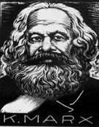
Karl Marx 1818 – 1883
Followed the first steps of the industrial revolution
Created a philosophy, an exact science to change the world
3 major branches :
The philosophy (dialectical materialism)
THE ECONOMIC DOCTRINE
The historical materialism of Marx and Engels
Obscurantism, French Revolution, illuminism, rationalism, materialism, historical and dialectical materialism
Notes:
The rationalist philosophy explains the human behavior as rational, better, having a logical and rational purpose.
Materialist philosophy explains that the purpose of human behavior is to obtain material benefits (wealth, power, etc.).
Historical materialism explains that the social evolution of humanity has been conditioned by the will of single individuals or groups of individuals who intended to obtain material benefits.
Dialectical materialism explains how the common race to the material benefits is harmful and how human society can be better organized.
The scientific socialism advocated by Marx wants to define an ideal society starting from the analysis of the real existing situation and in various transitory phases (Revolution - Transitional popular democracy - Dictatorship of the proletariat - Socialism, lower phase of communism - Communism) to reach the ideal society where the State is no longer necessary.
Utopian socialism proposes ideal but abstract or unsustainable solutions.
https://en.wikipedia.org/wiki/Illuminism
https://en.wikipedia.org/wiki/Historical_materialism
https://en.wikipedia.org/wiki/Dialectical_materialism
http://en.wikipedia.org/wiki/Karl_Marx
http://en.wikipedia.org/wiki/Friedrich_Engels
http://en.wikipedia.org/wiki/Marxism
http://en.wikipedia.org/wiki/Marxism%E2%80%93Leninism
https://en.wikipedia.org/wiki/Why_Marx_Was_Right
Book: Why Marx Was Right - Paperback English - By (author) Terry Eagleton

Slide 6
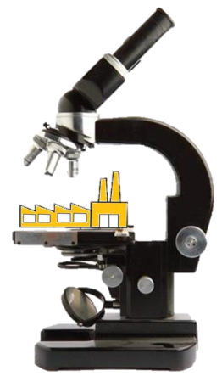
Some of the fundamental theories believed by Karl Marx:
The private ownership of land and production can
divide our society into social classes
(bourgeois and proletariat)
fighting themselves (class struggle)
Those who don’t have money have to sell their labour power.
Those who have money can buy the labour-power and use the surplus value created by labour.
Notes:
In the Middle Ages the classes were 3
Nobility-clergy, bourgeoisie, glebe
http://en.wikipedia.org/wiki/Proletariat
Michael Parenti: Democracy for the Few
The class struggle
Karl Marx identified 3 levels of the class struggle:
1 - The classic conflict between bourgeoisie and proletariat, or between the owners of the means of production and the workers.
2 - The patriarchal society - submission and exploitation of women.
3 - The conflict between exploiting and exploited peoples - slavery - colonialism - nationalism - struggle between the nations of the South and the imperialist nations.
According to Karl Marz, the class struggle must also be abolished by eliminating the prominence of social groups (blacks, Hispanics, women, natives, etc.) with the related sectoral demands. The struggle for freedom and justice must involve everyone without distinction
In order to be able to take sides clearly on the side of justice and of the exploited, it is necessary to take into consideration and know the class struggle. Unfortunately, today many political parties, including those of the left, have lost this capacity.

Slide 7
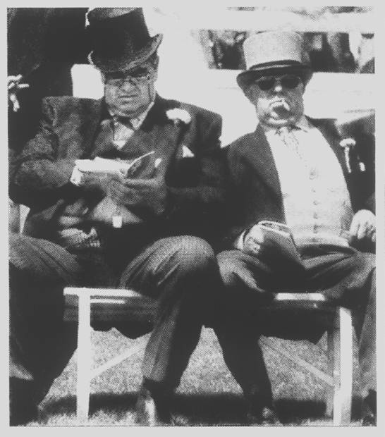

THE
CAPITALISTS
decide to build and sell motor-cars
The capitalists have an initial
capital, which (it is human!) they want to multiply. To have more is better!
On the bases of what is happening in the U.S., they decide to build cars and sell them to increase their capital.
Notes:
The capitalists have some initial capital that they (It's human!) want to multiply. To have more is better!
Following what is going on in the U.S., they decide to build and sell motor-cars to increase their capital.
Historically we known:
- The colonial capitalism (exploitation of the colonies)
- The industrial capitalism (exploitation of workers)
- The managerial capitalism (asset management and profit maximization)
- The financial capitalism (accumulation of capital)
The different forms of capitalism can coexist and take various aspects (example: colonialism and neo-colonialism).
http://en.wikipedia.org/wiki/Financial_capitalism
http://en.wikipedia.org/wiki/History_of_capitalism

Slide 8
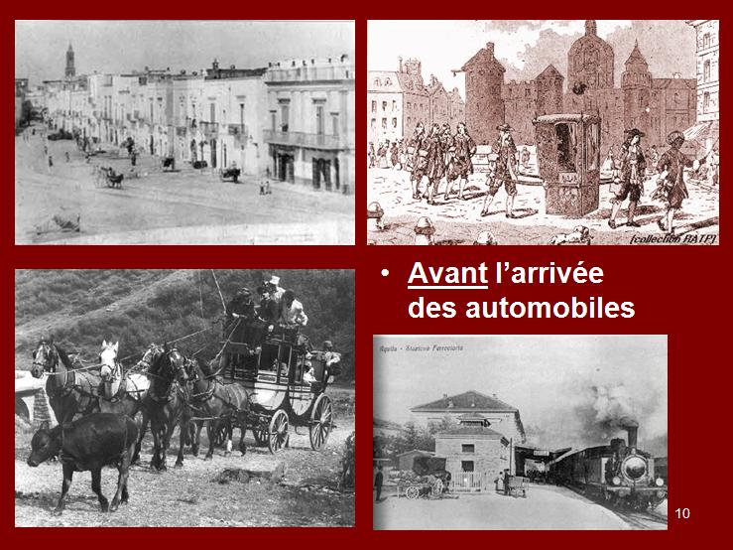
Before the arrival of motor-cars
Notes:
At that time people travelled only by walk, by horse, by carriages or by train. Cars did not exist.

Slide 9
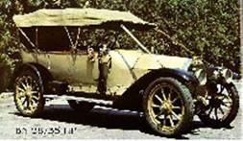
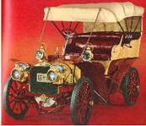
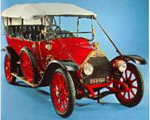
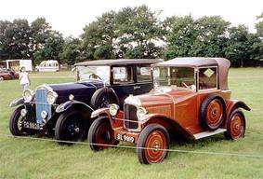
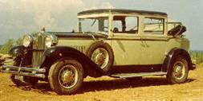
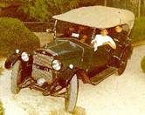
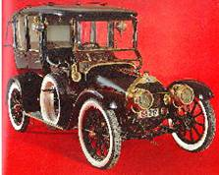
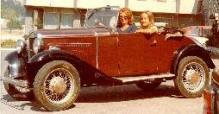
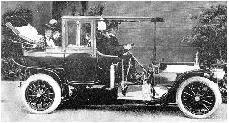
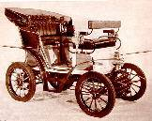
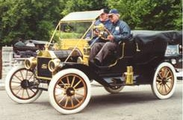
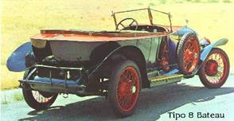
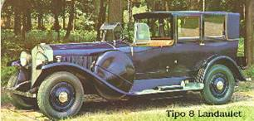
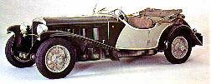
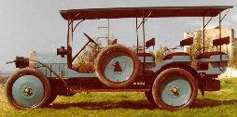
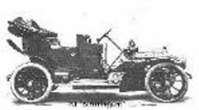
Cars at the beginning of the 20th century
9
Notes:
The first cars were a derivation of the horse-drawn carriages.
http://en.wikipedia.org/wiki/History_of_the_automobile
http://en.wikipedia.org/wiki/Antique_car

Slide 10
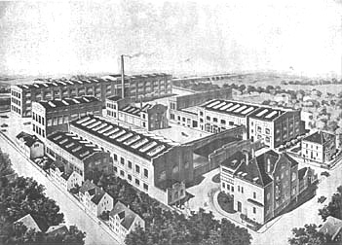
An old factory
Notes:
Industrialisation progresses

Slide 11
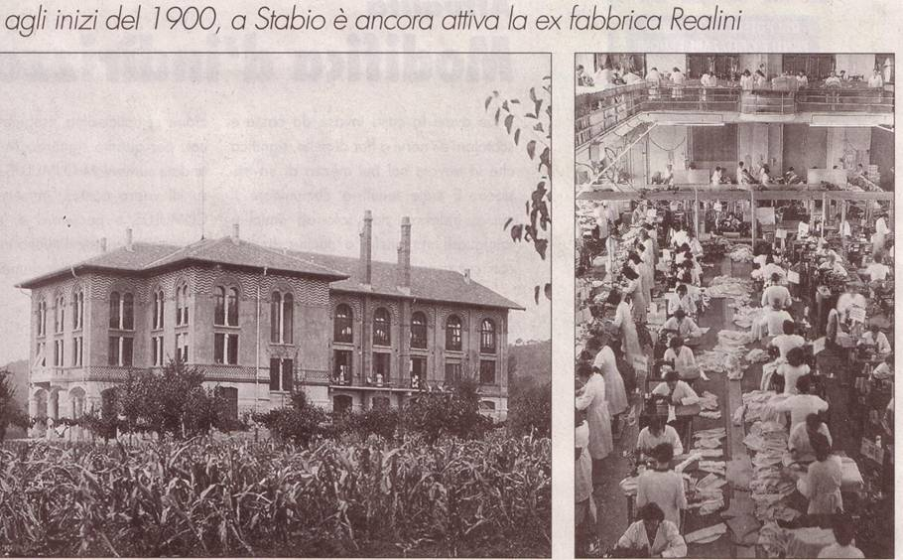
1900, Stabio-Switzerland: shirt production. In Switzerland, even today, many workers travelling from neighboring countries are exploited.
Notes:
At the beginning of the industrial revolution factories that exploit cheap manpower grow like mushrooms.
Stabio / Switzerland: shirts Factory. For example, still to day, along the border with Italy, there are factories exploiting the Italian workers crossing every day the border to work in Switzerland for a salary well below the usual minimum wage in Switzerland.
https://en.wikipedia.org/wiki/Stabio

Slide 12
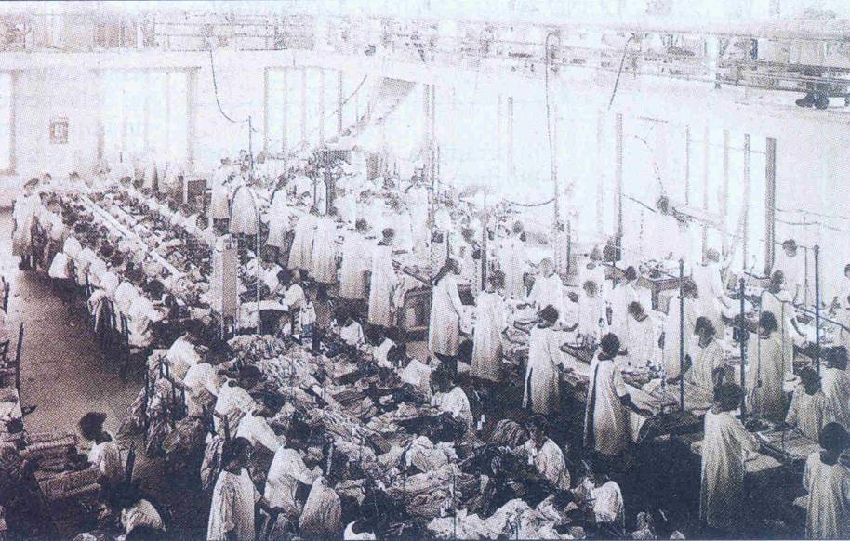
Shirt factory - Stabio Switzerland, early 1900
Many people working together on the production line.
Notes:
Many people work together at the same time and do the same work.

Slide 13
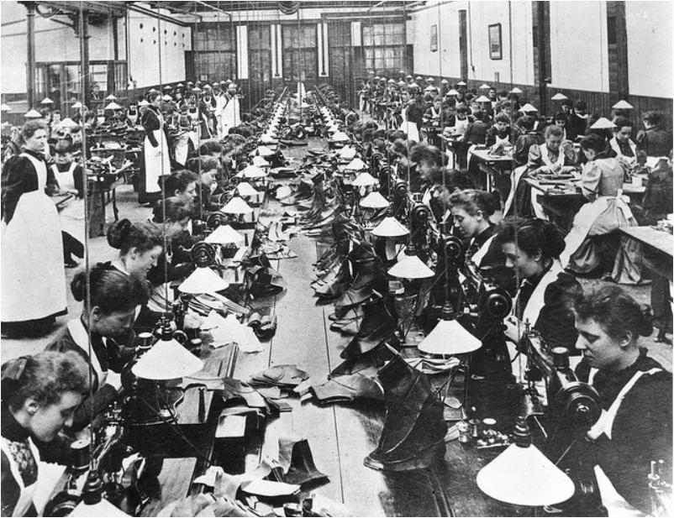
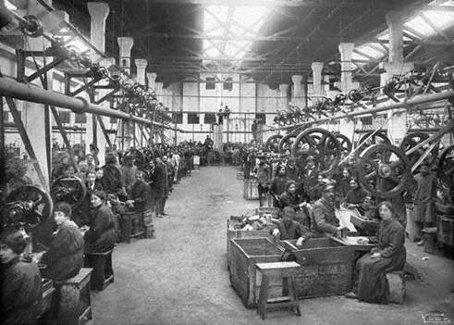
EARLY 1900’s
The working conditions are unpleasant
A Shoe factory
Notes:
In the early industrial establishments there are many workers and the working conditions are unpleasant

Slide 14
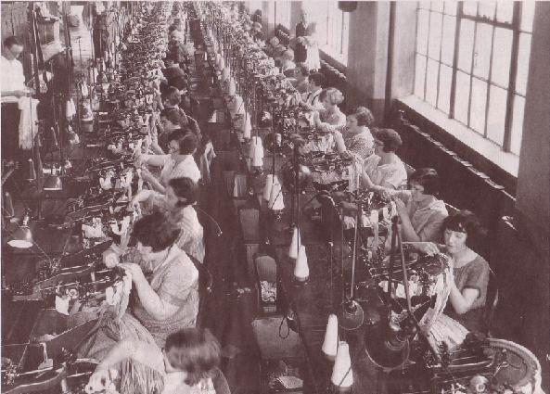
The owner takes advantage using cheap manpower
Linen factory in Brooklin 1919
Notes:
.

Slide 15
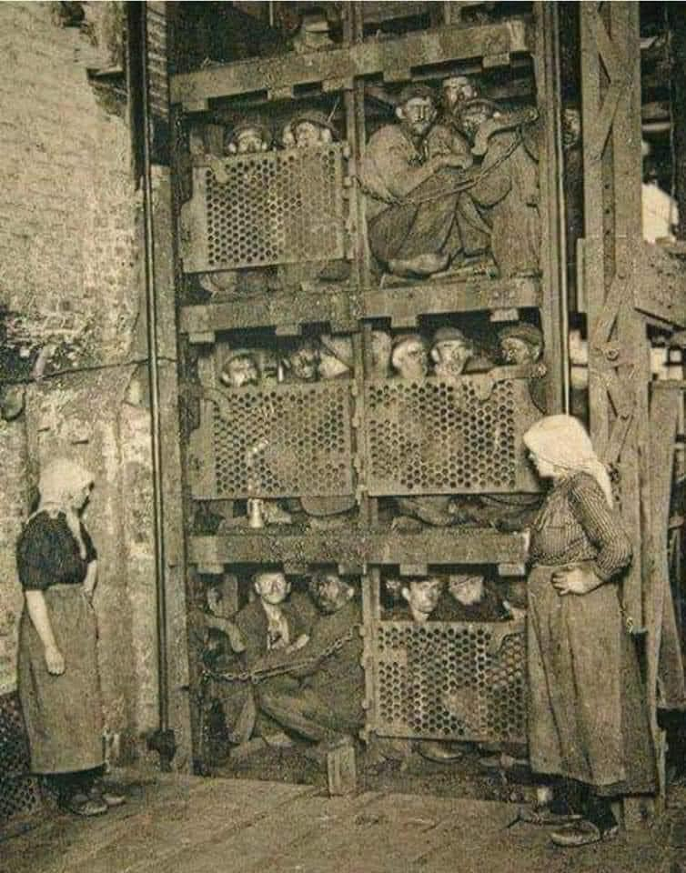
1900 Belgium
The hard life of miners.
Photo:
miners crammed into the lift coming up after 8 or 10 hour work in coal mine.

Slide 16
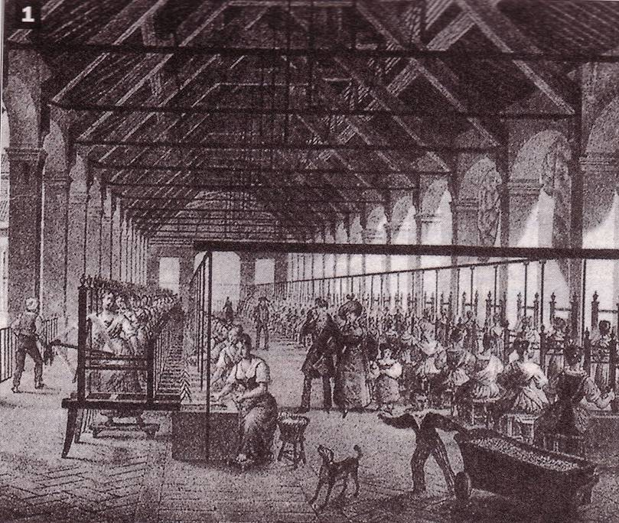
An owner visits his factory in the 19th century
For the first time workers realize that they are all proletarians
and have the same needs.
Silk spinning mill
Child working
Notes:
Silk spinning industrial plant of the early industrial revolution.
Workers spun the thread of the silkworm. Women and children also worked there for 12-14 hours a day 6 days a week.
For the first time hundreds of people (men and women, in this drawing there is also a child working) are together (in the factory for work) and discover that they have the same problems (fatigue, health, dirt, work time) and have the same interest (receiving the highest salary possible and work as little as possible). They see every day and personally the social difference between workers and the owner and his family. Workers become conscious that they belong to the proletarian class.
For the owner it is clear that his interest is to employ workers (men, women and children) as long as possible with the lowest salary possible.
The social conflict is inevitable.
The concentration of the workforce in a few large production units allow the owner to control better the workers and authorities to control the proletariat.
Image: Note that the working ladies are sitting on a stool without back, have to work sideways in turn, have to dip their hands in hot water, the room is not heated and probably exposed to the airflow, the floor is cold, there are guards that do not allow breaks, there is no work clothes or protection, there is no artificial lighting so probably the workday lasted from dawn until sunset.
http://en.wikipedia.org/wiki/Silk_industry_of_Cheshire#Silk_spinning
https://fr.wikipedia.org/wiki/Manufacture
https://en.wikipedia.org/wiki/Declaration_of_the_Rights_of_Man_and_of_the_Citizen

Slide 17
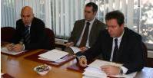
The capitalists engage a MANAGER
WHAT HE HAS TO DO:
Produce and sell motor-cars
Manage the motor-car factory
HIS MISSION:
MAKING THE HIGHEST PROFIT POSSIBLE ! ! !
It's him!
(He will be rewarded by a profit share)
Notes:
To encourage the manager to earn as much as possible, a portion of his salary is proportional to the gain: more the capitalists factory earn and higher is the salary of the manager. Exactly the mission is: “Making the highest profit possible , IMMEDIATELY and AT ANY PRICE." And also: "Maximizing the dividends".
https://en.wikipedia.org/wiki/Profit_(economics)
https://fr.wikipedia.org/wiki/Directeur_g%C3%A9n%C3%A9ral

Slide 18
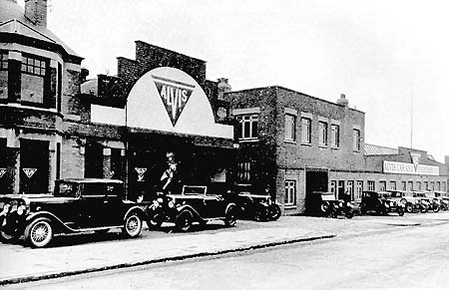
ALVIS MOTOR-CAR FACTORY, USA, 1929
A motor-car factory, bound to disappear because of the relentless competition from major rival producers.
Notes:
A motor-car factory bound to disappear because of the relentless competition from major producers.
http://en.wikipedia.org/wiki/Alvis_Car_and_Engineering_Company
http://en.wikipedia.org/wiki/Car_factory
http://en.wikipedia.org/wiki/Alvis_Firebird

Slide 19
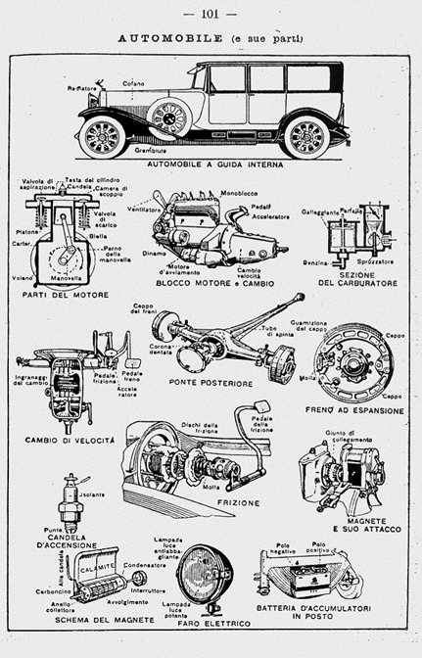
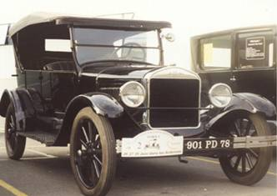
THE PROJECT
The first motor-car
« very modern »
Notes:
.

Slide 20
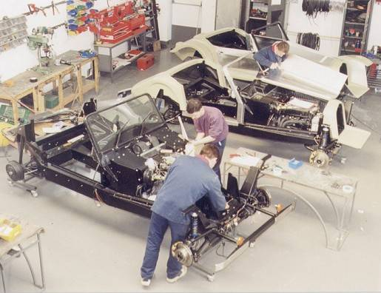
At the beginning the work atmosphere is familiar and human
MANUAL CAR PRODUCTION
BUFORI Factory, INDONESIA, 1995
Notes:
At the beginning the work atmosphere is familiar and human.
The employees are polymechanics dealing a little bit of everything.
http://en.wikipedia.org/wiki/Bufori

Slide 21
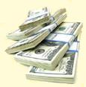
THE PRICE OF A CAR
Materials : 5’000.- $
Workforce: 5’000.- $
Fixed costs: 5’000.- $
Profit* : 5’000.- $
______________
Total 20’000.- $
Per il capitalista anche la posizione “Mano d’opera” è semplicemente un costo (le risorse umane) da ridurre il più possibile per poter aumentare al massimo possibile la posizione “Guadagno”
Notes:
20’000.- $ is the selling price of one car
For the capitalist the position "Workforce" is simply a cost (human resources) to reduce as much as possible in order to maximize their position “Profit“
* See next page

Slide 22
RULE No. 1
*Why «profit» ?
THE CAPITALISTS TAKE POSSESSION OF THE SURPLUS VALUE
CREATED BY THE WORKERS
Notes:
Profit: in reality it is the increase of value created by workers that transforms the semi-finished material into a finished and sellable car. In reality the increase of value created by workers belongs to the workers. In the capitalist economic system this value increase is called "profit" and the capitalist take possession of it (legally).
http://en.wikipedia.org/wiki/Added_value
http://en.wikipedia.org/wiki/Theories_of_Surplus_Value

Slide 23

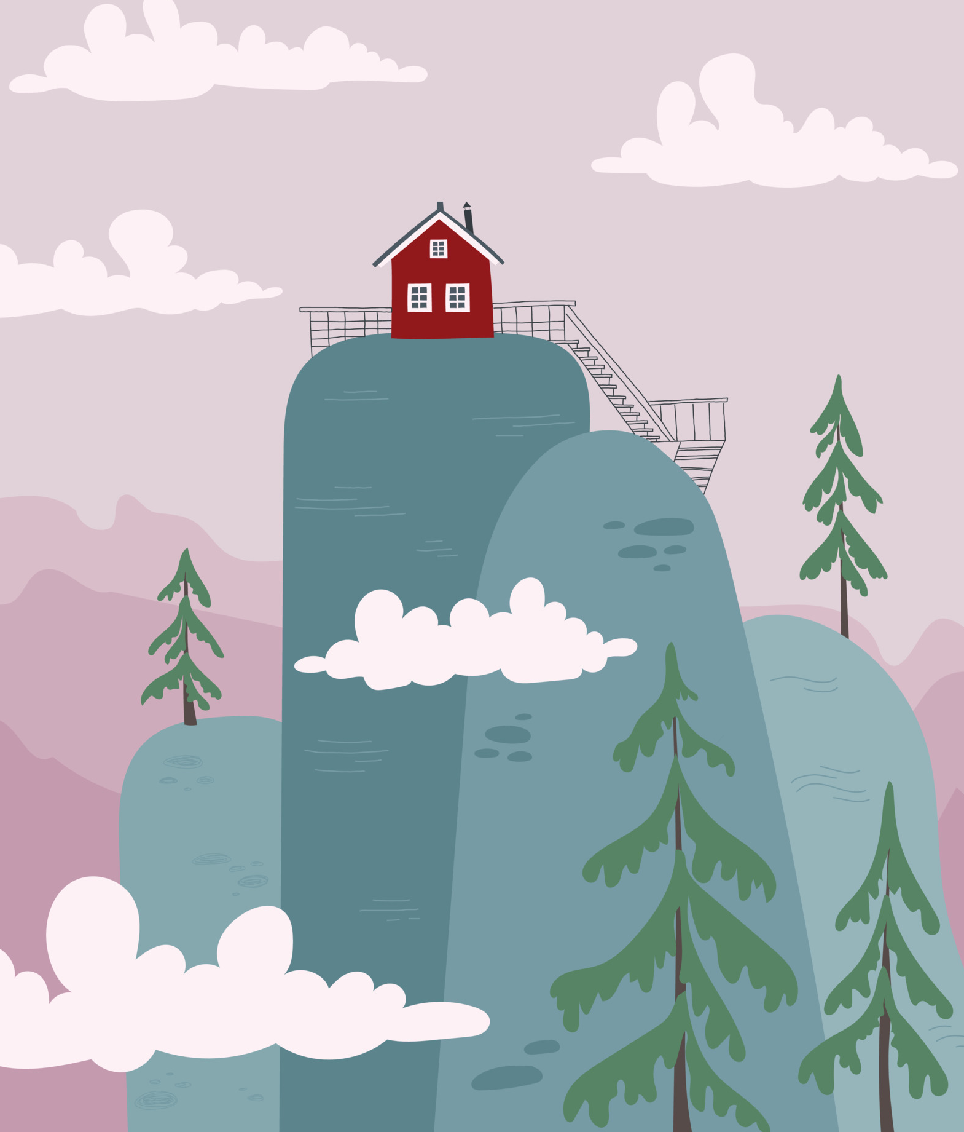
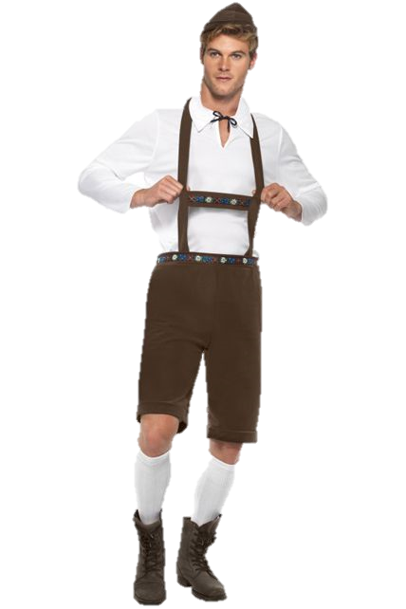
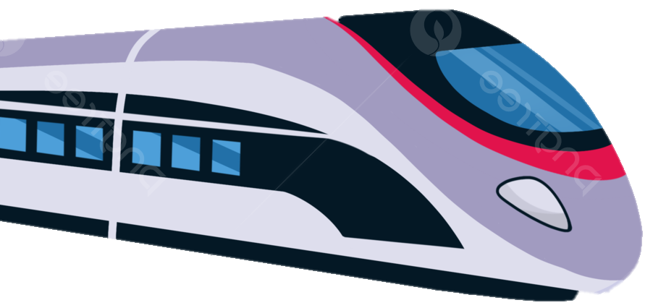

WHO BUYS A CAR?
PEOPLE WHO:
HAVE THE MONEY to buy a car
NEED a car
WANT to buy a car (accept the exchange money - car)
He has no money
He does not need a car
He does not want a car

Slide 24
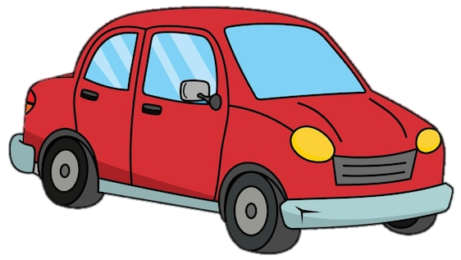



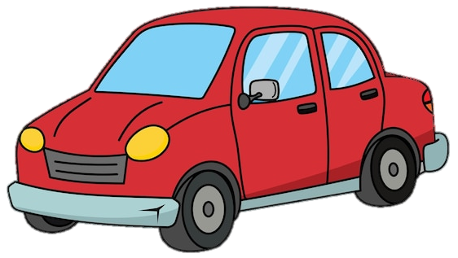

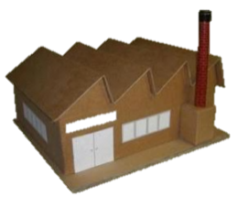




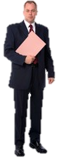


Buyers are being sought
The persons around the factory are those who have already bought a car and now they will not buy a second one.
Notes:
In the end ALL those who had enough money, who WANTED to buy a car and NEEDED it now have one, two or even three cars. Now the market is saturated and cars stay unsold.

Slide 25
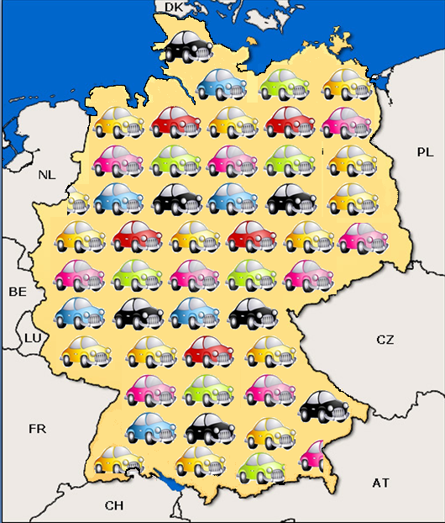
Soon
THE NATIONAL MARKET
IS SATURATED
What can be done?
Notes:
When all the people who have enough money to buy a car, who needed a car and were willing to buy it ... already have a car (and more than one), nobody buys cars anymore . The market is saturated. What to do?
http://en.wikipedia.org/wiki/Market_saturation
https://fr.wikipedia.org/wiki/Marketing_international#Saturation_du_march.C3.A9_domestique

Slide 26
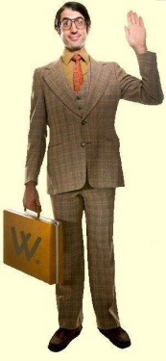
THE MANAGER DECIDES TO SELL THE W CAR ABROAD,
FOR EXAMPLE
..in France
The salesman goes to France, but…
Notes:
https://en.wikipedia.org/wiki/Export

Slide 27

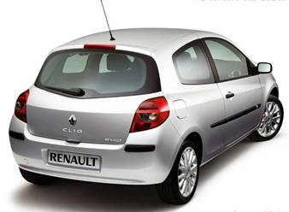
BUT IN FRANCE THE RIVAL BUSINESS IS NOT SLEEPING
$ 18’000.-
In France Renault corporation has also saturated the French market and is now trying to export to Germany.
Notes:
In France Renault corporation has also saturated the French market and now is trying to export to Germany
http://en.wikipedia.org/wiki/Renault

Slide 28
For the first time the W car factory is facing a rival business. It's commercial competition.
For this reason the W car needs to cost less.
The Manager decides…
That it is necessary to save on material and logistics.
(The producer speculates on the quality and quantity of materials used and on the storage and movement of the goods - providing "Just in Time“ supplies)
Notes:
Logistics is the technique of storage and handling goods.
Exercice: see slide 45

Slide 29
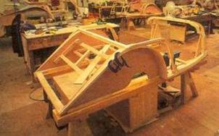
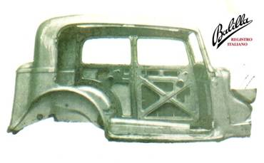
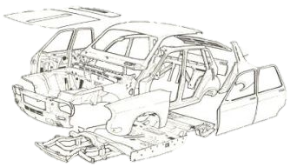


YESTER- DAY
Wooden supporting frame – Autounion, Germany, 1950
Wooden frame beginning 20th century cars.
Solid body of the '30s
Cars were strong
Châssis années ‘50
Built on ABS in the ‘60s
Notes:
Building cars needed a lot of time and a lot of manual work. The cars were very strong and heavy.
http://en.wikipedia.org/wiki/Car_frame
https://fr.wikipedia.org/wiki/Ch%C3%A2ssis_(automobile)

Slide 30





Pressed door
TODAY
Floor pressed and welded by laser
Side in 4 different thicknesses, laser welded
Automotive bodywork
Modern cars are beautiful and powerful … but fragile.
Notes:
Today cars are projected for their assembly by automatic machines. Modern cars are beautiful and powerful but fragile.
http://ilot.edu.pl/kones/2011/4_2011/2011_prochowski_zuchowski_comparative_analysis.pdf
http://www.alueurope.eu/wp-content/uploads/2011/12/1_AAM_Body-structures.pdf

Slide 31

Switzerland, April 2016. The fragile bodywork of this car did not withstand the impact and the driver died.

Slide 32



Traditional warehouse
The logistics
Notes:
There were warehouses with storekeepers
http://en.wikipedia.org/wiki/Logistics
http://en.wikipedia.org/wiki/Warehouse

Slide 33


Automated warehouse
Logistics
Notes:
The storekeepers have been replaced by an automatic system.
https://de.wikipedia.org/wiki/Hochregallager
https://en.wikipedia.org/wiki/Automated_storage_and_retrieval_system

Slide 34




Logistics automation
Notes:
Logistics automates and robots replace storekeepers and employees of the expedition services

Slide 35





Operator in a large automated warehouse. The port of Basel in Switzerland
Notes:
Logistics is very streamlined (container) and automated. Almost all goods reach Switzerland through the port of Basel or by railway through Basel and Chiasso
http://www.ralu.ch/der-basler-rheinhafen/

Slide 36








ROAD TRANSPORT
IS BECOMING MORE INVASIVE…
TIR
Notes:
Transportation on the road is said to cost less because we don't calculate the damage to the environment and to the roads caused by this transport system.
In Europe the customs have been removed and the goods can circulate quickly.
http://en.wikipedia.org/wiki/Truck
http://en.wikipedia.org/wiki/TIR_Convention
https://en.wikipedia.org/wiki/Free_movement_of_goods
https://fr.wikipedia.org/wiki/Camionnage
https://fr.wikipedia.org/wiki/Transport_international_routier

Slide 37





…but rail transportation is organizing itself.
Notes:
https://en.wikipedia.org/wiki/AlpTransit
http://it.wikipedia.org/wiki/Terminal_Hupac_di_Busto_Arsizio
https://en.wikipedia.org/wiki/Hupac

Slide 38

Harbor GioiaTauro, Italy
Notes:
http://en.wikipedia.org/wiki/Gioia_Tauro

Slide 39

Terminal Port Elizabeth, New Jersey
Container 20 feet: 6,0960 m ; 40 feet: 12,192 m ; B = 2,43 m, H = 2,59 m
Notes:
FEETS coeff. INCHES coeff. METERS DIMENSIONS
20 0,3048 0 0,0254 6,0960 length
8 0,3048 6 0,0254 2,5908 height
8 0,3048 0 0,0254 2,4384 width
40 0,3048 0 0,0254 12,1920 length
8 0,3048 6 0,0254 2,5908 height
0,3048 0 0,0254 2,4384 width
Currently the importance of the container in the field of maritime transport has reached such a level that it is estimated that about 90% of goods are transported through the use of about 200 million TEUs per year.
http://en.wikipedia.org/wiki/Containerization
http://en.wikipedia.org/wiki/Intermodal_container

Slide 40

We have to rationalize transport
Notes:
http://en.wikipedia.org/wiki/Sahel

Slide 41

It is necessary to rationalize transport
Notes:
.

Slide 42




Superjumbo
Lille: automatic underground
Shanghai: magnetic levitation train
Super tanker
Rationalizing needs always more: larger, faster, more automatic ...
Notes:
To rationalize all becomes more and more: more bigger, more faster, more automated ...
http://en.wikipedia.org/wiki/Superjumbo_jet
http://en.wikipedia.org/wiki/Oil_tanker
https://fr.wikipedia.org/wiki/Train_%C3%A0_l%C3%A9vitation_magn%C3%A9tique
https://fr.wikipedia.org/wiki/M%C3%A9tro_de_Lille_M%C3%A9tropole

Slide 43



Drones: the transportation and delivery system of the future
Robotic Postman
Driverless Bus
Notes:
http://en.wikipedia.org/wiki/Quadcopter
https://en.wikipedia.org/wiki/Unmanned_aerial_vehicle

Slide 44
Exercise
What is logistics?
The technique of storage and handling goods
What is logistically important in my country ?
The docks, the railways
Shipping, Transportation
What is your country doing to improve logistics?
Harbor, pipeline, railway, airport, motorways, etc.
Additional exercises: see below
Notes:
For teachers
Exercises to be done in working groups:
Enquire about the economic importance of logistics in your province / country (tons transported, sales, employees, etc..), Its supply chain, existing structures and ongoing projects, means of transportation, the environmental impact.
How to send a 5 t. heavy machine of the volume of a small van and with a value of 8 Mio Euro to China or to Argentina, where means of transport are available and which one to choose and why, duration of transport, transport costs, who / how goods are transported, how much do the custom fees cost?
http://en.wikipedia.org/wiki/Gothard_railway
https://en.wikipedia.org/wiki/AlpTransit

Slide 45
THE PRICE OF A CAR
(AFTER SAVINGS)
Materials : 5’000.- $ 2’500.- $
Workforce : 5’000.- $
Fixed costs: 5’000.- $
Profit : 5’000.- $
_________
Total 20’000.- $ 17’500.- $
Notes:
.

Slide 46

The salesman must sell the W car....
..in Italy
The salesman goes to Italy…
Notes:
.

Slide 47

In Italy FIAT also saved on materials and rationalized the logistics.
FIAT $ 16’000.-
47
BUT ALSO IN ITALY THE RIVAL BUSINESS IS NOT ASLEEP
Notes:
In Italy FIAT also saved on material and rationalized the logistics.
What to do?
http://en.wikipedia.org/wiki/Fiat_S.p.A.

Slide 48
The W car factory still faces rival business.
For this reason it is necessary that the W car costs less.
The Manager decides…
that it’s necessary to save on manpower.
(The producer forces the workers to work harder and also replaces some of them with machines)
The workers and the labour force are regarded as simply a commodity and consequently purchased and used.
Notes:
For the manager it is clear that if he fails to beat the rival business he cannot sell his W cars, and therefore he cannot collect the money, but this is not profitable for him. This is contrary to his mission of winning the maximum possible, so he is forced to act accordingly. Consequently he decides to save on manpower, even if this will cause sufferings to his own workers.

Slide 49
RULE No. 2
THE CAPITALIST, TO MAKE PROFIT AT ALL COSTS, OPPRESSES THE INDIVIDUALITY OF THE WORKERS.
(it is the exploitation of man by man)
Notes:
The new watchwords are:
Mor efficiency, increasing of productivity, rationalization, restructuration, salary of merit, deregulation, etc.
The results are also exacerbated competition among workers, stress, extension of working hours, increasing of working rhythm, less protection for workers against the employer, layoffs, casualization, working-poors, etc.
When Henry Ford, on the advice of Taylor, introduced the assembly line workers refused to work. Only the doubling of salary persuaded the workers to accept the assembly line. Obviously the quality of life of the workers worsened.
https://en.wikipedia.org/wiki/Exploitation

Slide 50




CAR ASSEMBLY LINE (recommended by F.W.Taylor) FORD CAR FACTORY , USA , 1915
Notes:
USA in early 20. Century Eng. Taylor taught how the production process has to work and created the assembly line. "Taylorism" is imposed on the Ford factory workers to increase productivity. For the workers the job becomes a nightmare.
The time required to assemble a car drops from 12 hours to 39 minutes.
Toyota introduces a working system that binds workers to the employer but guarantees a job for life and other advantages.
http://en.wikipedia.org/wiki/Assembly_line
http://en.wikipedia.org/wiki/Ford_Motor_Company

Slide 51

Charlie Chaplin "Charlot" on the assembly line, in the film "Modern times".
In the film Charlot went crazy because of the obsessive repetitiveness and the hellish rhythm of work.
Notes:
In a assembly line the cycle is the time that passes between the arrival of a piece until the arrival of the successive piece.
A cycle less than 3 minutes is harmful to the health of chain workers.
A three-minute cycle means that in an eight-hour working day the same operation must be repeated 160 times, and this for weeks ... and even for months.

Slide 52







FORD CAR FACTORY, USA , 1915
Notes:
Here work is already done at the assembly line, even if the workforce is still large.

Slide 53







FORD CAR FACTORY, USA , 1915
Notes:
Working under assembly line.

Slide 54




Assembly line:
(during the ’50s)
Fiat Topolino
Scooter Vespa
Audi – engine
2010
Notes:
The assembly line is spreading. Switzerland in the '30s introduced the assembly line in the watch industry
http://en.wikipedia.org/wiki/Fiat_Topolino
http://en.wikipedia.org/wiki/Vespa

Slide 55



CAR ASSEMBLY LINE
During the ’60s
(Citroën and Volkswagen)
Notes:
Assembly lines are more and more perfect.
http://en.wikipedia.org/wiki/Citro%C3%Abn
http://en.wikipedia.org/wiki/Volkswagen

Slide 56

ASSEMBLY LINE
Notes:
Always: assembly line.

Slide 57



ROBOTS WORKING IN CAR ASSEMBLY LINES
Notes:
Automatic machines (robot) replace assembly line workers

Slide 58





Workers on modern assembly lines.
Notes:
Few specific operations are still performed by the hand of a woman or a man.

Slide 59

Toy factory assembly line in China
Notes:
The atmosphere, the work time and the rhythm are like hell

Slide 60

TEXTILE INDUSTRY: HONG KONG 1970
The hell of the work = working like hell: all this to produce more.
Notes:
The hell of the work = working like hell: all this to produce more.

Slide 61




INDONESIA
GLOBALIZATION
PHILIPPINES
VIETNAM
SRI LANKA
Notes:
Everywhere the same movements and the same rhythm. No time to smile to the photograph. It is the globalization of the work chain that enslaves humanity.
Globalization, the Corona-virus pandemic and environmental problems have highlighted how interdependent the economies of all countries are. If we want a better future in this context, there is no longer any place for nationalisms, separatisms, parochialisms and egoisms. The need to redistribute wealth and the work to create it is also increasingly evident.
https://en.wikipedia.org/wiki/Globalisation

Slide 62


Haiti is the poorest country in the world:
here the workforce is available at very low prices.
Cuba
Haiti
South America
Notes:
Hanes Factory, Haiti
http://action.sumofus.org/a/haiti-hanes/?sub=fb
http://usas.org/2012/01/24/tell-gildan-and-hanes-reinstate-haitian-union-leaders-immediately/

Slide 63

Globalization
Chinese factories in Ethiopia, workers must work hard but their wages are very low.
Notes:
Here workers have to work about 66 hours a week and receive less that 1 $ a day.
http://blogs.wsj.com/corporate-intelligence/2014/05/15/why-made-in-ethiopia-could-be-the-next-made-in-china/
http://reportage.corriere.it/esteri/2014/made-in-ethiopia-la-nuova-fabbrica-del-mondo/

Slide 64








Cina
Java
Mexico
Paid to the factory in Indonesia: 12%
Globalization
Wages: 0,4 %
Materials: 8 %
Other costs: 1,6 %
Profit: 2 %
Albania
The workers receive only 0.4% of the proceeds from sales.
Peru
India
Bosnia
Notes:
The proportion indicated in the sheet is generally valid for all products and industrial sectors with low and medium added value with production in low-wage countries. The proportion also applies to raw materials produced or extracted in third world countries: cocoa, cotton, wood, bananas, coltan, etc. etc. In many of these cases, deforestation, excessive use of soil and water or pollution created by the extraction or processing of raw materials or the production of low-value goods are added to the exploitation of local labor. In many cases, there is also the exploitation of child labor and in general very low incomes insufficient to allow workers to lead a dignified life.
https://en.wikipedia.org/wiki/Shoe
http://www.quora.com/How-much-does-a-pair-of-Nike-shoes-cost-to-produce
http://en.wikipedia.org/wiki/Value-form#Real_prices_and_ideal_prices
http://en.wikipedia.org/wiki/Shoemaking
http://en.wikipedia.org/wiki/Value-form#Real_prices_and_ideal_prices

Slide 65





Even in Shoe factories machines replace workers
Adidas shoe printed in 3D
Exercise: What are the economic, human and social implications of manufacturing shoes, houses, tools, bones fit for human transplantation, weapons, etc. by automatic machines or 3D printers ?
Notes:
https://en.wikipedia.org/wiki/3D_printing
Exercise:
Need less workers (more unemployed people), cost less, less worktime, more profit for the machines owners, less quality of the product, need high knowhow, less transportations costs, with 3D printer everybody can make – no control, high-tech products are reserved to the rich countries only, etc.

Slide 66





In this
Bangladeshi factory
1000 workers
died
Safety is neglected
In this
Bangladeshi
Factory
100 workers
died
Notes:
http://en.wikipedia.org/wiki/2013_Savar_building_collapse
http://en.wikipedia.org/wiki/List_of_industrial_disasters

Slide 67

Electronics industry
1980
The work of this lady is repetitive, soon she will be replaced by a machine
Notes:
Inescapable: in future each piece will be projected according to a mechanical production.
The lady in the photo probably built switches.

Slide 68

ELECTRONIC COMPONENTS ASSEMBLY LINE WORKERS
Notes:
In many factories the assembly line is a reality

Slide 69





Assembly line of washing machines
The machine does the hard part of the work but must be operated by a man. One day soon there will be a machine that will do everything alone.
Notes:
Assembly lines are introduced in all branches of production.

Slide 70


Control room
SWISS METAL-MECHANICAL INDUSTRY:
LARGE AUTOMATIC UTENSILES MACHINES
Notes:
The remotely controlled machines replace workers

Slide 71



TRADITIONAL METAL MECANICAL PLANT
AUTOMATED METAL MECHANICAL PLANT
Notes:
Mechanical metalworker is a qualified profession. Despite that, he was replaced by a machine.

Slide 72

Welding robots in action
Notes:
Even workers specialized in welding have been replaced by an automatic machine.
https://en.wikipedia.org/wiki/Welding_robot

Slide 73

AUTOMATIC PACKAGING MACHINE
Everything is automatic. Now there are some specialised workers only. The machine does the manual work.
Notes:
Everything is automatic. Now there are some specialized workers only.

Slide 74

SWISS METAL-MECHANICAL INDUSTRY: automatic machines The "islands" follow a pre-established path and are transporting the parts from one forming station to another.
Notes:
Automation everywhere

Slide 75




The modern worker: the ROBOT
Robot working on Pelton turbine
The robotic personal assistant: the COBOT helps in the laboratory
The robotic
vacuum cleaner
Notes:
Everywhere programmed automatic machines (robots) replace the workers, even if they are specialized.
http://en.wikipedia.org/wiki/Robot
http://en.wikipedia.org/wiki/Robotics
https://en.wikipedia.org/wiki/Pelton_turbine
http://www2.deloitte.com/content/dam/Deloitte/uk/Documents/finance/deloitte-uk-finance-robots-are-coming.pdf
Lawrence Michel (2015), “The Missing Footprint of the Robots”, 13 mai

Slide 76




Robot replaces workers
He can write !
Notes:
The storekeeping robot, the stonemason robot, the mechanic robot, the graphic robot (is able to write)
https://en.wikipedia.org/wiki/Erik_Brynjolfsson
https://en.wikipedia.org/wiki/Automation
http://raceagainstthemachine.com/
http://secondmachineage.com/
https://www2.deloitte.com/content/dam/Deloitte/lu/Documents/operations/lu-intelligent-automation-business-world.pdf
http://www.bbc.com/news/technology-34066941
http://www2.deloitte.com/content/dam/Deloitte/uk/Documents/finance/deloitte-uk-finance-robots-are-coming.pdf

Slide 77






THE ROBOTIC
INVASION
77
Notes:
The limits of automation:
Erik Brynjolfsson et Andrew McAfee (2014), The second Machine Age
Jörg Luyken (2015) «Are robots about to take away 18 millions jobs?», thelocal.de, 4 mai

Slide 78






Electroerosion machine
Head for extrusion
ELECTROEROSION
AND EXTRUSION
Plastic window
Screw pump
cooling
Engine
heating
head
Extruder
Extrusion
Notes:
With electro-erosion procedure (AGIE Losone Switzerland) the head (matrix) of extruder can be manufactured in a simple, fast and economical way (with little labor). Heads / matrix of extruders are metal plates with a hole with a complex form through which metal or plastic kept in a soft state is pushed. When leaving the head the mass takes the form of the hole and then it is cooled immediately. It becomes a PROFILE. Before the electro-erosion process was invented, building a matrix for the extruder took a long time and large manual labor. Thanks to the initiative of the Engineers of AGIE corporation many residents of Locarno found a job and an income to live.
http://en.wikipedia.org/wiki/Extrusion
http://es.wikipedia.org/wiki/Electroerosi%C3%B3n
http://fr.wikipedia.org/wiki/%C3%89lectro-%C3%A9rosion
https://fr.wikipedia.org/wiki/Extrusion_d%27un_plastique

Slide 79


Today: automation
Yesterday: manual work
Notes:
.

Slide 80

Production of plastic pipes by extrusion
Notes:
You have to think that there are people who pass 40 years of their lives in these factories.

Slide 81




Progress in the textile sector has eliminated many workplaces
Manual loom
1745 The first completely automatic loom.
1800
The mechanical loom driven by steam power machine appears
Modern textile industry
Notes:
This is the beginning of the Industrial Revolution (large industries) and of the great inventions: the steel, the steam engine, the railways, the steamships made of iron, automatic weaving machine, the new materials, the electricity and the telegraph, etc.
Weaving becomes automatic. Needless to destroy the machines (as did the English workers in 1700). It is impossible to stop the progress; but it represents an advantage specially to the owners of the machines.
http://en.wikipedia.org/wiki/Northrop_Loom
http://en.wikipedia.org/wiki/Lancashire_Loom
http://en.wikipedia.org/wiki/Loom
http://en.wikipedia.org/wiki/Textile_industry#mediaviewer/File:Raschelei.jpg

Slide 82




Streamlining in the construction industry
Notes:
Prefabrication in the construction branch is always increasing

Slide 83



CONSTRUCTION IN THE FUTURE
Notes:
Preconstruction at all levels is steadily increasing.
Netherland, students home.
Today, many single-family homes are prefabricated
http://en.wikipedia.org/wiki/Prefabricated_building

Slide 84




1448 Gutenberg printing press
1880 Linotype machines for composition
Manual composition
Old mecha-nical rotary
Notes:
In 1950 to publish a newspaper with a circulation of 100,000 copies 100 people were needed, including printers and shipping
http://en.wikipedia.org/wiki/Gutenberg_printing_press#Gutenberg.27s_press
http://en.wikipedia.org/wiki/Linotype_machine

Slide 85




1990 :
Computerized composition and photocomposition Automatic rotary
2011 :
Tablet, the electronic virtual newspaper
Notes:
Today, to publish a newspaper with a circulation of 100,000 copies 20-30 people (or less) are needed
With the new communications systems the newspaper pages can be transmitted to all parts of the world and there, with the photocomposition, they can be transformed into matrix ready for the press.
Today the Tablet appeared on the market. It is a small portable data processor with a large screen which allows to receive and read the newspapers (and not only) in any place and at any time. Although the saving of wood to make paper protects the forests, the paper industry, printing and distribution of the newspaper, any printer and the movies are no longer needed with associated loss of jobs.
Already today, thanks to informatics and Internet, a newspaper can be created, published and distributed worldwide by one person.
http://en.wikipedia.org/wiki/American_Type_Founders#Photocomposition
http://en.wikipedia.org/wiki/Phototypesetting
http://en.wikipedia.org/wiki/Tablet_computer

Slide 86





Western Union operating room, Broadway, New York, 1881
Administrative work before computerization required a large number of employees
Today
Notes:
The computer creates 2 new jobs but destroys 10

Slide 87





Old manual sorting office
Postal workers have been replaced by automatic sorting machines
For the manual sorting of letters a lot of employees were needed
Today an optical system reads addresses even if they are handwritten.
Modern postal sorting office
Until 1990…
Notes:
Because of the mechanization and automation in the postal sector thousands of jobs have been eliminated.
By requiring users to hold a post office box. Post company save the distribution made by a few postman, but at the same time requires all users to go by them self to the post office. In this way the Post limelight on the user cost of distribution. But the postman are unemployed.
http://en.wikipedia.org/wiki/Post_office
https://en.wikipedia.org/wiki/Postman
https://en.wikipedia.org/wiki/Post-office_box

Slide 88







Modern call center
Once there were operators
Evolution of the telephone
Today it is all automatic
Notes:
The operators had to establish connections manually.
The electromechanical telephone center were still asking the human presence for connections and maintenance.
In the modern electronic telephone center everything is remote controlled and man work is needed only to replace the trays with exhausted electronic circuits.
http://en.wikipedia.org/wiki/Telephone
http://en.wikipedia.org/wiki/Telephony

Slide 89




Mining and stone processing: machines replace the human workforce
Notes:
The good stonemasons (they were almost artists) have been replaced by machines driven by unskilled workers.
http://en.wikipedia.org/wiki/Stonecutter
http://en.wikipedia.org/wiki/Quarry

Slide 90











In agriculture, machines and chemistry have replaced people and animals.
Notes:
http://www.vietnambreakingnews.com/2013/10/quang-ninh-invests-in-agricultural-mechanization/
http://en.wikipedia.org/wiki/Mechanised_agriculture
https://en.wikipedia.org/wiki/GMO
https://en.wikipedia.org/wiki/Pesticide

Slide 91




Motta Milan 1950, the preparation of candied fruits
Yesterday
Today
Notes:
Fruit processing manual and semi-mechanical

Slide 92



In the internet sales empire of AMAZON employees are subjected to exhausting work patterns and wages are low with precarious job prospects... already there is talk of complete automation ...
At the same, time thanks to its gigantism and the data of billions of customers, AMAZON is trying to influence national policy and penetrate all areas of the economy and even public administration.
Notes:
Note the closed work environment and the repetitive task
http://www.lucianavone.it/il-greenwashing-di-amazon/
http://bizbeatblog.dallasnews.com/2013/01/new-amazon-warehouses-are-big-projects-for-developer-hillwood.html/
http://www.businessinsider.com/working-at-amazon-no-free-food-and-a-low-salary-2012-11

Slide 93




3 train drivers
2 train drivers
Streamlining in the railway sector
1 train driver
0 train drivers
Notes:
The British experience has shown that even in the railway sector too much rationalization and privatization reduce safety.
In addition, in the case of privatization, forcibly increase rates because in the prices must be included the gain that the state-owned company, in charge of the public service, not necessarily want / need to achieve.
https://en.wikipedia.org/wiki/Railroad_engineer

Slide 94

Where is the best location for this factory?
Why?
THE FACTORY WITHOUT WORKERS
Notes:
The factory without workers works day and night and produces plastic parts. This factory is in Japan. The owner is managing his factory by computer. Providers load the plastic granulate in the machines, make the maintenance of the machinery and remove the packages with the products ready for shipment.
Question: Is it worthwhile for the owner to move his factory to China where labor costs less?
Where is the best location for his factory? (Zug, Switzerland – like Glencor-Xtrata commodity trade corporation )
And what are the criteria of his choice? (taxes, security, safe energy, transport links and easy and safe, cost of land and construction, proximity to suppliers and customers, various incentives, etc.), or in central Europe or in the USA.

Slide 95

Kunshan, Shanghai, China: Foxconn, the entirely robotized factory that produces components and accessories for mobile phones
Notes:
In 2017, the company Foxconn claimed that want to start up a million robots

Slide 96

Other ways to save on workforce:
Exploitation of illegal migrants. Also blackmailing
(illegal work, prostitution, etc.).
Subcontracting at different levels
Management leasing
Relocation of production in Eastern Europe, China, etc..
(Example of the shoe factory placed on a ship moving from one port to another in search of cheaper workforce)
- Neglecting the safety of workers and neglecting environmental protection regulations.
Notes:
Examples of environmental pollution:
Asbestos / Eternit - Bhopal - Seveso, oil tanker sinking, oil platforms, etc..
Example of the anti-smoke filters at Monteforno factory Bodio which were disconnected at night time to save money.
Management leasing: the mother company (lessor) leases a branch to a lessee company, which operates it on its own, but with the obligation to buy the goods from the lessor and deliver part of the proceeds to the lessor. In order to make a profit, the lessee is obliged to save on labour while the mother company is exempt from labour management and business risks.
Example: Carrefour in France, Mac Donald, etc.
https://en.wikipedia.org/wiki/Guest_worker_program
https://en.wikipedia.org/wiki/Amianthus
https://en.wikipedia.org/wiki/Eternit
https://en.wikipedia.org/wiki/Bhopal_disaster
https://en.wikipedia.org/wiki/Seveso_disaster
https://en.wikipedia.org/wiki/Factory_ship

Slide 97
The attack on the workers
To weaken the bargaining power of workers and to reduce their
wages the capitalists use all their power and influence
Workers are divided into several categories, treated and paid differently
By gender and age: men, women, young, active, older, retired
By function: workers, employees, officers, managers, directors
Depending on qualification: trainees, contractors, laborers, skilled graduates, academics
According to the working time: / shift auxiliaries, freelance
Depending on the retribution: job contract, hour wages, monthly wages, bonus payments, profit sharing etc.
The capitalists are opposed to any union activity and penalize unionised workers.
Capitalists create their own commissions and yellow unions.
Capitalists make use of outsourcing and employ temporary staff.
The capitalists have sought approval of laws that reduce worker’s rights and limit trade union activity.
The capitalists threaten mass layoffs and factory closure. Mobbing is used.
The capitalists reward the most servile workers.
Notes:
.

Slide 98

more hours, same salary
INCREASE IN WORKERS EXPLOITATION
VW ON 2006 :
FROM 28,8 HOURS TO 35 HOURS WEEKLY
WITHOUT SALARY INCREASE

Slide 99

The economic system crushes the workers and even impacts their private life
Work weakens the new samurai
Increase in the number of couples who do not have sexual relations
because working 10-12 hours a day
Notes:
To satisfy the requirements of the employers workers have to sacrifice even the most private relationships and the satisfaction of some basic needs such as sexual relations, family relations, the pause and the rest etc.
It is precisely the rule of K. Marx: to make profit at all costs the capitalist alienates the worker’s personality.
http://en.rocketnews24.com/2013/08/26/five-things-that-keep-japanese-people-chained-to-their-jobs/

Slide 100

Supermarket checkout
Bank counter
Ticket counter
Self-service checkout
Cashpoint
Tcket machine
In everyday life people are confronted with ever more Automation. The ultimate goal being to save man-power costs by turning work and responsibility over to the user. Human contact is lost.
Notes:
.

Slide 101
THE PRICE OF A CAR
(AFTER THE LATEST SAVINGS)
Materials : 5’000.- $ 2’500.- $
Workforce: 5’000.- $ 2’500.- $
Fixed costs: 5’000.- $
Profit : 5’000.- $
_________
Total 20’000.- fr 15’000.- $
Notes:
Thanks to the savings and rationalizations the car now costs 15’000.-

Slide 102
The salesman must sell the W car....
..in Sweden
The salesman goes to Sweden, but…
Notes:
.

Slide 103

$
IN SWEDEN
VOLVO SELL
THEIR CAR AT THE
PRICE OF
PRICE LIST
$
In Sweden Volvo also saved on manpower using the assembly line and machines.
Notes:
The Manager decides that his factory must export the W cars to Sweden.
But in Sweden Volvo also saved on manpower using the assembly line and automatic machines.
What to do?
https://en.wikipedia.org/wiki/Volvo_Cars
https://en.wikipedia.org/wiki/Volvo

Slide 104
The W car factory is faced again with the rival business.
For this reason it is necessary that the W car costs less.
The Manager decides:
it is necessary to save on fixed costs
How does that work? What are fixed costs?
Notes:
Fixed costs also exist when the factory is closed: for example, interest, mortgage interest, dividends, the maintenance costs of buildings, insurances, etc..
http://en.wikipedia.org/wiki/Fixed_cost

Slide 105









To spread the fixed costs over a larger number of produced cars
like mortgage interest, buildings maintenance, depreciation, insurance, rentals, etc.
the producer concentrates production under one great big roof.
Notes:
Fixed costs exist also even the factory is closed, for example, mortgage interest, rent, building maintenance, depreciation, insurance, etc ...
https://en.wikipedia.org/wiki/Fixed_costs

Slide 106

ITALIAN MOTOR-CAR FACTORY TORINO : FIAT
Factory Mirafiori (inaugurated in 1936 by Mussolini)
To produce more and therefore better distribute the fixed costs over the produced units, the capitalists concentrate the production in ever larger factories.
Notes:
To produce more and therefore better distribute the fixed costs over the produced pieces, the capitalists concentrate the production in ever larger factories.
http://it.wikipedia.org/wiki/Fiat_Mirafiori

Slide 107

The FIAT Mirafiori Plant today
Notes:
5000 people are working actualy in this factory. Now FIAT is togheter with Chrisler.
http://it.wikipedia.org/wiki/Fiat_Mirafiori

Slide 108


Individual mobility
becomes a right,
the dependency on oil
becomes a fact.
A large flow of cars
THE FIFTEEN MILLIONTH FORD T LEAVES THE ASSEMBLY LINE
DETROIT , USA , 1929
Notes:
Ever larger factory are ever producing more cars that also need to be sold
https://en.wikipedia.org/wiki/Ford_T

Slide 109
Ciba
Ciba-Geigy
Geigy
Novartis
(about 120’000 employees)
Sandoz
?
Hoffmann-
La Roche
Roche
Roche
(about 80’000 employees)
Genetech
Boehringer
Ventana
LARGE MERGERS IN THE SWISS PHARMACEUTICAL INDUSTRY
To rationalize and reduce the costs the capitalists centralize and merge.
Notes:
To rationalize and reduce the costs the capitalists centralize and merge.
How many employees will have a hypothetical company resulting from the merger of Novartis and Roche?
https://en.wikipedia.org/wiki/Corporate_merger

Slide 110
SBG
UBS
(about 80’000 employees)
SBV
?
SKA
CS
(about 50’000 employees)
SVB
Bank Leu
LARGE MERGERS IN THE SWISS BANKING INDUSTRY
Notes:
Who acquired whom? Obviously, those who have more money can dictate the game, such as the small SBV of Basel Switzerland seizing control of the powerful SBG that had billions of debt because of losses on the derivate products market.
How many employees will have a hypothetical company resulting from the merger of UBS and CS?

Slide 111
THE PRICE OF A CAR
(AFTER THE LATEST SAVINGS)
Materials: 5’000.- $ 2’500.- $
Workforce: 5’000.- $ 2’500.- $
Fixed costs: 5’000.- $ 2’500.- $
Profit: 5’000.- $
_________
Total 20’000.- fr 12’500.- $
Notes:
.

Slide 112
The salesman must sell the W car....
..in Japan
The salesman goes to Japan, but…
Notes:
.

Slide 113

IN JAPAN TOYOTA SELLS CARS LIKE THE W CAR FOR
$
$
Also in Japan they are producing even more units to save on fixed costs.
113
Notes:
The Manager decides that it is necessary to export the W cars to Japan.
But also in Japan they are producing even more to save on fixed costs.
What to do?
https://en.wikipedia.org/wiki/Toyota_Motors
https://it.wikipedia.org/wiki/Toyota_Production_System

Slide 114
The W car factory is again faced with a rival business.
For this reason it is necessary that the W car costs less.
The Manager decides:
it is necessary to reduce the profit.
(reluctant decision because his mission is to make the highest possible profit)
Notes:
The decision to reduce the profit is the last possibility left to the Manager to reduce production costs. Of course the Manager is aware that this decision would not please the capitalists, but the competition leaves him no choice.
Either cut costs/profit and Saleprice or close.

Slide 115
THE PRICE OF A CAR
(AFTER THE LATEST SAVINGS)
Materials: 5’000.- $ 2’500.- $
Workforce: 5’000.- $ 2’500.- $
Fixed costs: 5’000.- $ 2’500.- $
Profit : 5’000.- $ ? $
_________
Total 20’000.- $
market price
At this point the market will indicate the price at which it is possible to sell the W car this means the price that buyers are willing to pay.
If production costs are higher than the market price it would be impossible to sell W car for a profit, on the contrary, it is likely they would be sold at a loss. And this the capitalist does not like at all.
Notes:
At this point the market will indicate the price at which it is possible to sell the W car, that means the price that buyers are willing to pay.
If production costs are higher than the market price it will be impossible to sell W cars with a profit, on the contrary, probably they should be sold with a loss. And the capitalist doesn’t like that at all.
http://en.wikipedia.org/wiki/Value-form#Real_prices_and_ideal_prices
http://en.wikipedia.org/wiki/Profit
https://en.wikipedia.org/wiki/Market_price

Slide 116
Rule No. 3
COMPETITION CAUSES A POTENTIAL LOSS OF PROFITS
Notes:
.

Slide 117






The car culture:
By car…
living
travelling
working
dying
going to the cemetery
Notes:
The car is now present in all sectors and stages of human life.

Slide 118










The car culture:
The car is the King
Notes:
The car is a way of life
http://en.wikipedia.org/wiki/Lunar_Roving_Vehicle

Slide 119











The car culture
Notes:
Today the car is with us everywhere.

Slide 120








The car culture
Notes:
Today the car is life and fun

Slide 121























Supercar
Batmobil
Notes:
.

Slide 122





THERE ARE TOO MANY CARS
PARKHOUSE
Notes:
Modern human society is built and organized around the car
http://en.wikipedia.org/wiki/Multi-storey_car_park

Slide 123



Cars inspire artists
In Geneva the cars are looking beautiful
But cars require motorways and the motorways are covering the country.
California
Notes:
http://en.wikipedia.org/wiki/Autostadt
https://fr.wikipedia.org/wiki/Salon_de_l%27automobile_de_Gen%C3%A8ve

Slide 124

What we build for cars!
Notes:
.

Slide 125

SWITZERLAND
FIVE MILLIONS VEHICLES
Security and confort more important that ecology
Notes:
Almost each one has at least a car.
Now the car is a normal consumer good.

Slide 126



There are too many cars
Chinese motorways
Notes:
Cars in circulation on the planet: the total is more than 1'000'000'000. There are 250'000'000 only in the US - 100’000’000 in China / 5,000,000 only in Beijing
Cars produced in 2010: 60'000'000 = 165,000 per day - in China are produced 300 models by 52 Chinese brands and 170 models of 23 foreign brands
1/4 of cars are produced in China,
1/2 of cars are produced in South-East Asia
1/3 of cars are produced in Europe
In China there are 70 cars per 1000 inhabitants
In the G7 countries 700 cars per 1000 inhabitants

Slide 127

We don’t know where to put all these cars...
Notes:
http://en.wikipedia.org/wiki/Autostadt

Slide 128




There
are too many
motorways

Slide 129

If we continue like this....
Notes:
A road node difficult to resolve…

Slide 130







Some are looking for alternative ways .... others are dreaming, but this is not a solution.
The game is over !
Notes:
.

Slide 131





The global market is saturated:
Everyone who:
HAS ENOUGH MONEY
NEEDS A CAR
WANTS TO BUY A CAR
now has a car.
(and even more than one)
What do we do?
Notes:
http://en.wikipedia.org/wiki/Market_saturation

Slide 132
The W car factory is faced with saturation of the global market.
The salesmen are not able to sell W cars anymore because:
-people don’t have money to buy a car
people don’t need a car because they already have one or more than one
people do not want to buy a car (the streets are blocked by cars)
The manager informs the Board of Directors (the capitalists)
Notes:
The car business is over!
In recent years, several car factories have had to close and / or have been purchased and "restructured" by other groups.
Like Rolls Royce (BMW), Opel, SAAB, Chrisler, ecc.
https://en.wikipedia.org/wiki/American_car_bailout

Slide 133

The capitalists realize that producing and selling cars is not profitable anymore and they… decide to abandon this business.
Notes:
Often it is not the owner or capitalist who decides to close the factory but the Authorities at the request of creditors.

Slide 134





The car factory is closed:
workers must go.
Notes:
Overproduction has saturated the market. Now everyone has a car, or even two or three. The salesmen are no longer able to sell cars = no more cash earning / no more profits.
Little by little the factories and production sites close down, the workers are dismissed or unemployed.
http://www.abc.net.au/news/2013-05-23/ford-closure-sends-shockwave-through-manufacturing-industry/4708584
http://www.pressherald.com/2014/10/01/verso-paper-to-close-bucksport-mill-displacing-500-workers/
http://www.nidirect.gov.uk/unfair-dismissal
https://en.wikipedia.org/wiki/Effects_of_the_2008%E2%80%9310_automotive_industry_crisis_on_the_United_States#Production_capacity:_factory_closings

Slide 135




Due to overproduction the market is saturated. Everybody now has a car, or even two or three. The salesmen cannot sell the cars anymore = no more money will be collected = no more profit.
Little by little the plants and factories close down, the employees are fired and are now unemployed.
UNSOLD NEW CARS
Notes:
Because of market saturation storehouses are full of unsold cars and goods.
https://en.wikipedia.org/wiki/Consignment_agreement
https://www.curioctopus.it/read/9008/dove-finiscono-le-auto-invendute-ecco-le-impressionanti-immagini-dei-cimiteri-di-macchine

Slide 136



WINNERS AND LOSERS
THE WINNERS:
THE CAPITALISTS (they increased their capital)
THE MANAGER (he got rich)
THE CAPITALIST SYSTEM
THE LOSERS:
THE WORKERS
THE COMMUNITY (must now support the unemployed people)
THE ENVIRONMENT (is polluted)
(they are poor like before, they lost their jobs, security and perhaps also their health)
(has imposed his rules and determined the relationships between humans)
Notes:
A contradiction discovered by Marx:
The capitalist system is one of those great superstructures created by humans, but which then grew out of all proportion, remained autonomous and escaped the control of humans, subjugating them and imposing his strict rules on them until he destroyed the humans themselves and so also itself. In this system, individuals also entrust him with the satisfaction of their needs. Consequently, in the long run, the capitalist system is NOT sustainable.
http://www.oxfam.org/en/pressroom/pressrelease/2014-01-20/rigged-rules-mean-economic-growth-increasingly-winner-takes-all-for-rich-elites

Slide 137

DISTRIBUTION OF WORLD ECONOMIC ACTIVITIES IN 1991
PERCENTAGE OF THE WORLD TOTAL
GDP – 84.7 %
World commerce 84.2 %
Family savings – 85.5 %
Family investments – 83 %
THE RICHEST FIFTH
Each segment represents 1/5 of the world population
GDP – 1.4 %
World commerce 0.9 %
Family savings – 0.7 %
Family investments – 0.9 %
THE POREST FIFTH
Notes:
The unfair distribution of wealth
GDP – 84.7 %
World commerce 84.2 %
Family savings – 85.5 %
Family investments – 83 %
Each segment represents 1/5 of the world population
GDP – 1.4 %
World commerce 0.9 %
Family savings – 0.7 %
Family investments – 0.9 %
Gini coefficients of representative income distributions
http://en.wikipedia.org/wiki/Gini_coefficient
http://www.indexmundi.com/facts/indicators/SI.POV.GINI/rankings
https://en.wikipedia.org/wiki/Gross_domestic_product
https://en.wikipedia.org/wiki/Human_Development_Index

Slide 138



The millionaires in the world
The 10 nations with the most billionaires
Il caffè della domenica, 1. dicembre 2013
Never before have the richest in Switzerland been so rich
Notes:
Most of the richness of our planet is held by very few people but very rich
http://www.chartbookofeconomicinequality.com/inequality-by-country/switzerland/
http://www.tdg.ch/economie/Repartition-des-richesses-la-Suisse-est-pire-que-des-dictatures/story/17309463
Thomas Piketty: Capital in the Twenty-First Century
http://en.wikipedia.org/wiki/Capital_in_the_Twenty-First_Century

Slide 139

Poverty in the USA in 2010
Notes:
The Huffington Post Nicole Hardesty First Posted: 10/18/10 04:58 PM ET Updated: 05/25/11 07:05 PM ET
America's Poor: Where Poverty Is Rising In America (INFOGRAPHIC)
http://www.huffingtonpost.com/2010/10/18/americas-poor-a-regional-look_n_766852.html
Also:
http://www.huffingtonpost.com/tag/federal-poverty-line

Slide 140



1 %
99 %
Oxfam
Report
2014
1% of the world population owns
50% of the world's wealth, or 180 trillion dollars.
The 85 richest people on the planet have as much wealth as 3.5 billion of the poorest people.
In 2013, the fortunes of the rich increased and in 29 of 30 surveyed countries, the taxes for the rich have decreased. 18.5 billion has been hidden from the worlds Tax Authorities.
Notes:
http://www.oxfam.org/en/pressroom/pressrelease/2014-01-20/rigged-rules-mean-economic-growth-increasingly-winner-takes-all-for-rich-elites
Http://www.huffingtonpost.it/2014/01/21/oxfam-working-for-the-few_n_4634976.html?utm_hp_ref=italy
http://en.wikipedia.org/wiki/Gini_coefficient
http://en.wikipedia.org/wiki/Oxfam
Thomas Piketty: Capital in the Twenty-First Century
http://en.wikipedia.org/wiki/Capital_in_the_Twenty-First_Century
https://en.wikipedia.org/wiki/Michael_Parenti
https://en.wikipedia.org/wiki/Joseph_Stiglitz
https://en.wikipedia.org/wiki/William_Beveridge

Slide 141

The billionaires of the world, according to OXFAM
(www.oxfam.org.uk - OXFAM BRIEFING PAPER – JANUARY 2018)
Notes:
The "rich" do not create wealth. The rich keep their wealth. If they created wealth they would be called "workers“ (Karl Marx).

Slide 142
RULE No. 4
CAPITALISM CREATES:
CAPITAL ACCUMULATION
(creation of large economic empires (corporations), large landholdings, economic and business agreements, etc.)
Notes:
Growth of great economic empires related to large commercial enterprises (corporations), even multinational.
https://en.wikipedia.org/wiki/Capital_accumulation
MULTINATIONAL CORPORATIONS, GLOBALIZATION AND POVERTY:
http://info.worldbank.org/etools/docs/library/89443/tu_0601/newfarmer.pdf
Robert B. Reich: "Saving Capitalism”

Slide 143


Diamond does not stop the wave of layoffs
90 workers have lost their jobs
In the same newspaper, two different stories.
THE POOR ARE ALWAYS POORER
AND
THE RICH ARE ALWAYS RICHER
The differing income of Americans
The detailed analysis shows strong increases for the wealthiest
Notes:
While workers are laid off, the rich get always richer ..
Forbes magazine has published the list of the richest people of the world: each year their assets increases.

Slide 144








THE
WINNERS
AND… The losers
Notes:
The difference between rich and poor grows and grows

Slide 145

THE HOMES OF RICH PEOPLE
THE HOMES OF POOR PEOPLE
Philippines
Notes:
The difference between rich and poor is evident also in the look of their homes.

Slide 146



WHERE ARE THE RICH AND... WHERE ARE THE POOR
Notes:
No comment

Slide 147

Italy: Albarella, the island for rich people
Notes:
The Albarella island is located near Venice and is completely private and exclusive.
http://it.wikipedia.org/wiki/Isola_di_Albarella
http://www.albarella.it/it/isola-di-albarella

Slide 148




South Africa
The slums: the cities of the poor
Notes:
https://en.wikipedia.org/wiki/Slum

Slide 149

Rio de Janeiro: favela Rochina
Notes:
https://en.wikipedia.org/wiki/Favela_da_Rocinha

Slide 150


In Switzerland every year two million tons of food are wasted
It is a scandal: some have too much food and others have too little!
Notes:
Swiss newspaper «20 minuti» , 12th October 2012

Slide 151




Strike at Boilat (Swissmetal) Reconvilier Switzerland 2005
THE LOSERS (the workers) PROTEST
Strike
Notes:
Dismissed workers and unemployed people protest. Their existence is threatened.
http://www.nidirect.gov.uk/unfair-dismissal
https://en.wikipedia.org/wiki/2011_Wisconsin_protests#Protests

Slide 152


In 2008, after a two-month strike of the workers at the railway factory
in Bellinzona (Switzerland), the Manager of SBB
Mr. Mayer abandons the plan to close the factory and concentrates the maintenance of locomotives in Yverdon
Notes:
http://www.rsi.ch/news/ticino-e-grigioni-e-insubria/cronaca/Le-Officine-nella-storia-da-sei-anni-400773.html
But after ten years, helped by the State, the director Maier won and the workers were forced to accept a strong reduction in jobs.

Slide 153

New York city 1930, great depression : Jobless people waiting in front of the labour office
Notes:
To occupy the unemployeds the US government devised the method to dig a trench to a team of workers and then close it by another team. An unnecessary work but allowed to pay wages, which in turn allowed the unemployeds and their families to survive.
Only later was it realized that it was more efficient to deliver the money directly to the unemployeds (unemployment benefits) without forcing them to perform humiliating unnecessary work which took advantage of the only manufacturers of equipment for excavation.
In Nazi Germany, the unemployed were employed to build highways and other public infrastructures.
https://en.wikipedia.org/wiki/Great_depression

Slide 154









THE LOSERS
Notes:
A multitude of unemployed people (the losers) demand a work, some food, a home…
https://www.youtube.com/watch?v=cEuxFg6h3sk
https://www.youtube.com/watch?v=KAh6l2ja3vE

Slide 155





Tanker accident
LOSERS: the Environment and the weakest
Notes:
Just to produce and earn more, capitalists have no respect for the environment
https://en.wikipedia.org/wiki/Natural_environment
https://en.wikipedia.org/wiki/Air_pollution

Slide 156



Losers:
The environment
and the weakest
Notes:
The traces of capitalism and consumer society

Slide 157




A LOSER: THE ENVIRONMENT
Notes:
Traces of wild consumption of goods

Slide 158


A LOSER :
THE
ENVIRONMENT
Rubbish Dump full of batteries
Notes:
What is left after consumption

Slide 159



A LOSER:
THE ENVIRONMENT
The final product of our economic system
Notes:
The final product of our economic system.
https://en.wikipedia.org/wiki/Waste
http://www.trashedfilm.com/

Slide 160






2010
Gulf of Mexico
1978
Atlantic: Amoco Cadiz
POLLUTION
A LOSER: THE ENVIRONMENT
1986
Cernobil
2011
Fukushima
Notes:
The future of our economic system….
https://en.wikipedia.org/wiki/Exxon_Valdez_oil_spill
https://en.wikipedia.org/wiki/Amoco_Cadiz_oil_spill
https://en.wikipedia.org/wiki/Chernobyl_disaster
https://en.wikipedia.org/wiki/Fukushima_Daiichi_nuclear_disaster
https://en.wikipedia.org/wiki/Deepwater_Horizon_oil_spill

Slide 161




The landscape is devastated
Notes:
.

Slide 162

Sometimes we recycle
Notes:
http://en.wikipedia.org/wiki/Paper_recycling
http://en.wikipedia.org/wiki/Recycling_of_plastic

Slide 163







Often toxic waste produced by our economic system ends up in third world countries, like Ghana and Niger.
A LOSER :
THE THIRD WORLD
Notes:
Often the waste generated by our economic system ends up in the third world
http://www.blacksmithinstitute.org/files/FileUpload/files/Additional%20Reports/hidden.pdf

Slide 164









A LOSER : THE THIRD WORLD
Notes:
Often the waste generated by our economic system ends up in third world countries.
https://en.wikipedia.org/wiki/Pollution
http://www.who.int/heli/risks/ehindevcoun/en/
https://en.wikipedia.org/wiki/Toxic_Colonialism

Slide 165





A LOSER :
THE ENVIRONMENT
Lake Baikal
DESERTIFICATION
Climate change caused by man provokes major disasters
Notes:
The future of our economic system ...
http://en.wikipedia.org/wiki/Desertification

Slide 166




Climate change caused by man produces major disasters
Notes:
http://en.wikipedia.org/wiki/Climate_change
http://en.wikipedia.org/wiki/Transition_town

Slide 167


OUR FUTURE ?
Notes:
http://en.wikipedia.org/wiki/Water_pollution
https://en.wikipedia.org/wiki/Seawater_pollution
https://en.wikipedia.org/wiki/Anthropization

Slide 168

The fall of civilisation. Alarming report by the UN:
severe shortage of many resources.
The intensive and uncontrolled exploitation of resources and environmental mismanagement is driving us to disaster. This is what the UN says!
Notes:
... the future of our planet.

Slide 169

The survival factors of humanity
ocean level
The outside of the circle represents the uncontrollable survival factors.
The inside of the circle represents the survival factors that humans can control.
The area where humans live is represented in light green: in balance between controllable and uncontrollable survival factors.

Slide 170

Keep calm: everything is alright!

Slide 171


According to LENIN :
Imperialism
IS
the highest stage of capitalism.
With international agreements TTIP - TISA - CETA, etc. imperialism wants to dominate the world.
Notes:
http://en.wikipedia.org/wiki/Imperialism
http://en.wikipedia.org/wiki/Imperialism,_the_Highest_Stage_of_Capitalism
MULTINATIONAL CORPORATIONS, GLOBALIZATION AND POVERTY:
http://info.worldbank.org/etools/docs/library/89443/tu_0601/newfarmer.pdf
TTIP - Ceta - Tisa: are some international agreements that North-American imperialism wants to impose on the rest of the pro-Western world, ostensibly to boost trade by eliminating customs barrier, but in reality to subjugate the countries of the Western bloc to the will of the US / Canada in a liberal and imperialist perspective. These agreements would favor only large international Corporations (especially from the US) to the detriment of the economy and national sovereignty of other signatories.
An example is the irreversibility clauses from any measure of liberalization / privatization that individual States or individual local authorities can take, the unlimited duration of the agreements, the primacy of the liberal rules, the possibility for States and corporations to appeal to a special primed supranational court, etc. Considering that China, Russia and Iran are excluded a priori, as well as the urgency and secrecy surrounding these agreements, it is quite clear that these agreements serve mainly to the US to assembly its field in anti Russia / China view. In practice it is realized the provisions of Lenin 100 years ago: Imperialism dominates the world and dictates the rules of the game.
https://en.wikipedia.org/wiki/Transatlantic_Trade_and_Investment_Partnership
https://en.wikipedia.org/wiki/Trade_in_Services_Agreement
https://stop-ttip.org/material-list-for-information-on-ttip-ceta-tisa/

Slide 172






The worlds largest Stock exchange is Wall street in New York
Brokers in action
The Stock exchange of Milan
Financialisation of economy
In the capitalist system the commerce of property certificates (shares) and credit certificates (bonds), commodities, currencies, real estate, etc.. have an enormous size. Every day notes for billions of dollars are exchanged.
The prices rise and fall rapidly, creating huge losses but also allow some people to become rich very quickly.
Notes:
The capitalist economic system is based on money lent by the central bank to other banks, which in turn lend it to their customers. Obviously this river of money is destined to return in the banks and to the central bank, plus interest ... but that means that the money supply is growing constantly hand in hand with the indebtedness of the state and the population and the accumulation of money by a few and banks. This system is called finance seignorage.
The excesses of the speculation of the stock market create speculative bubbles (prices are too high) followed by deep financial crises that hits the entire economy.
Speculation is favored by the use of derivative financial instruments that allow to buy or sell anything without possessing it. Modern technology has globalized financial markets that respond in unison. The financial sector (banks, insurance, investment funds, administration, commerce, etc..) became a huge machine that gives work to hundreds of thousands of employees whose only goal is the highest profit. Often to prevent the collapse of the entire system, with catastrophic consequences, the states are forced to intervene with enormous amounts of money that finally are provided by taxpayers and / or small savers.
The money is born with the need to create a neutral commodity accepted by all. At first, the money was used to pay the mercenaries, taxes and goods, to make loans, etc.
The parable of the money can be summarized as follows: (G = Goods, M = Money)
G - G (barter): Operation socially useful but has organizational limitations
G - M - G (the sale of merchandise to buy the other): Operation socially necessary but not much productive
M - G - M (the purchase and resale of the same goods for profit): Operation socially unproductive
M - M - M (the purchase and resale of currencies for profit): Operation socially damaging
The life of the money is based on CREDIT which is opposed to the DEBT, as well as the obligation to repay the money borrowed and the compensation to be paid for the received loan (interest). The concession or non-concession and the repayment or non-repayment of a loan and / or payments or non-payments of the interest can have serious consequences especially on the weakest part of the population.
Classic: the debts of third world countries.
http://www.imf.org/external/np/res/seminars/2013/arc/pdf/Krugman.pdf
Currency Regimes, Capital Flows, and Crises / Autor: Paul Krugman
Paper presented at the 14th Jacques Polak Annual Research Conference
Hosted by the International Monetary Fund
Washington, DC─November 7–8, 2013
http://en.wikipedia.org/wiki/Financial_markets
http://en.wikipedia.org/wiki/Stock_market
http://en.wikipedia.org/wiki/Bond_market

Slide 173










Interest on State bonds
Securities: stocks, bonds, various investments which are operated by the users themselves or by major social insurances (pensions, old age pensions, disability pensions, savings-linked, etc.)
? : Unsure
Speculation
Subsidys, pensions,,old people allocation, allowances, etc.
repayment tresury bonds (?)
Money is the sap of capitalism
Support the economy,
state orders (Keynes)
Loan,
securities repayment (?)
Appropriation of the added value
Money loan – discount rate (Friedman)
Loans
Goods and services, securities repayment (?)
Profits
EU
IMF
WB
scriptural money, tresury bills
Debt
Loans repayment, fees, etc. ?
Goods and services payment, work
securities ?
Loans repayment ?
Accumulation
Taxes, fees, loans repayment ?
Loans repayment, securities
?
THE PERVERSE CYCLE OF MONEY
Investments, repayment, taxes, fees, tax evasion, bankruptcy, etc. ?
Abroad
Taxes, fees, treasury bonds, etc. ?
Because of capital accumulation by the capitalists and the appropriation of overvalue, non-payment of taxes, non-repayment of loans, etc. the system leads creditors to bankruptcy with consequent disruption of the entire economic - financial system.
Notes:
Debt classic example: Greece 2013
http://www.positivemoney.org/
The “green” part of finance could possibly also work. The uncontrolled draw out (shown in red) from this part by the capitalist brings the system in disequilibrium with the debt of the public body (left) and an accumulation by capitalists (right).
Note: This diagram is simplistic to regard the relationship between private banks and the central bank / state, because in fact most of the money (scriptural) is created and put into circulation by banks and partly also lent to the State. The State raises capital by selling bonds, for example, Treasury bonds (treasury bills).
When the state is too indebted neo-libériste recipe is always the same: privatize everything that is "public" (to replenish the coffers of the State), reduce provides and cost of sociality (to limit output ), reduce the costs of labor (to make domestic industry more competitive ), reduce business taxation (to make them more competitive) and rich taxation (to attract wealthy foreigners), introducing taxes and levies for the people, and so on. Rarely tax increases for the rich, in part because they are in good relations with those who decide and because he engaged in tax evasion and / or move their goods abroad.
All this is called "reforms." The result is poverty, unemployment, low wages, exploitation of labor, the exorbitant prices of privatized services (must produce profits) whose quality becomes lower, widening social differences, repression of protests, creating a scapegoat (the political opposition, minorities, foreigners, etc..). The next step is social disorder, the establishment of a dictatorial or authoritarian government, civil war when not directly war.
http://en.wikipedia.org/wiki/FED
http://en.wikipedia.org/wiki/European_Central_Bank
http://www.snb.ch/en/
http://en.wikipedia.org/wiki/World_bank
http://www.worldbank.org/
http://en.wikipedia.org/wiki/IBRD
http://go.worldbank.org/SDUHVGE5S0
http://en.wikipedia.org/wiki/Bretton_Woods_system
http://en.wikipedia.org/wiki/International_Monetary_Fund
http://en.wikipedia.org/wiki/Fractional-reserve_banking
http://tinyurl.com/balance-sheet-extension
https://en.wikipedia.org/wiki/Bank_for_International_Settlements
http://www.bankofengland.co.uk/publications/Documents/quarterlybulletin/2014/qb14q101.pdf
http://www.bankofengland.co.uk/publications/Documents/quarterlybulletin/2014/qb14q102.pdf
https://en.wikipedia.org/wiki/Krugman
http://becurioustv.com/fr/show/fast-and-curious/episode/19-mai-les-suisses-aiment-ils-vraiment-leurs-banques-1
http://news360x.fr/les-banques-creent-a-partir-du-neant/
http://news360x.fr/un-banquier-suisse-explique-en-3-minutes-larnaque-de-la-creation-monetaire-avec-le-canada-comme-exemple/
https://en.wikipedia.org/wiki/AM-Lira

Slide 174




This means of payment and the electronic (or scriptural) money that is on the accounts belong to the Bank that issued them (in this case to UBS). The seigniorage (interest) remains to the bank. In case of bankruptcy of the bank, all the electronic money of the customers' accounts enters the assets of the bankruptcy estate.
In Switzerland, metal coins are minted by the Federal Mint and then sold at the nominal price to the National Bank. The difference between the production cost and the nominal price is the seigniorage, which in this case goes to the Swiss Confederation (about 5 million Fr. / year).
In Switzerland, banknotes are printed by the National Bank.
Banknotes
Metal coins
These means of payment belong to the Swiss National Bank which rents them to those who need them, primarily the banks.
Damaging or destroying these means of payment is a crime.
In Switzerland, the money supply (M1) is around 600 billion Swiss francs. The National Bank controls only metal coins and banknotes, representing 10% of the money supply. Electronic money represents 90% of the money supply.
Electronic money
The swiss money supply (M1)
Notes:
The money supply M1 is the currency in circulation, i.e. the means of payment that are in circulation, including electronic money. In Switzerland it amounts to around 600 billion Swiss francs. Of these, 90% are electronic money, while 9% are banknotes and 1% are metal coins.
The Swiss National Bank, and in general all the central banks of the Western world, do not have control over electronic money (which is issued by banks) but limit themselves to monitoring to quantify the money supply in circulation.
In Switzerland (as well as in many other countries), banks must ONLY deposit an amount equal to 0.25% of the issued amounts with the Central Bank. However, the National Bank CANNOT limit or prevent in any way the issuance of electronic money by banks, hence a continuous and uncontrolled growth of the money supply also because an important part flows into the financial markets.
https://it.wikipedia.org/wiki/Aggregati_monetari
https://en.wikipedia.org/wiki/The_Capitalist_Conspiracy
http://en.wikipedia.org/wiki/Money_circulation#Destruction
http://en.wikipedia.org/wiki/Money_creation
http://en.wikipedia.org/wiki/Credit_money
http://en.wikipedia.org/wiki/Bank_money
http://it.wikipedia.org/wiki/Riserva_frazionaria
http://tinyurl.com/balance-sheet-extension
In Switzerland at the end of the 19th century, the state issued coins while almost every bank (including some cantons) issued its own banknotes. The confusion was enormous.
At the beginning of the 20th century, the Swiss National Bank was created: it had a monopoly on the issue of coins and banknotes. However, private banks began to issue virtual or electronic money (for example with credit cards and computerized payment transactions). Consequently, the money supply has grown much more than the real economy, creating various dangers. Today 10% of the money supply is banknotes and coins, while 90% of the money supply is electronic money (scriptural money).
Only the SNB should be able to issue money, including electronic money. These means of payment should enter into circulation debt-free and interest-free through the state, local authorities and citizens. In this case, the state will no longer have to ask for loans from banks (now the state pays enormous interest each year on the debt that the state owes to the banks). The National Bank should also be regulated by a precise constitutional mandate. In this case, the means of payment will still flow to the banks which will be able to carry out their work as before, but the money supply is under control.
The fractional reserve is a guarantee that the banks have to create with the National Bank. In the Euro area, the deposit amounts to 2% of the bank's debts. (in Switzerland it is 2.5%). http://arjelle.altervista.org/Economia/Pillole/riserva_frazionaria.htm

Slide 175


Notes:
Modern Money Theory (MMT): http://memmt.info/site/
www.recommon.org/
http://www.vollgeld.ch/index.php
http://www.positivemoney.org/
https://en.wikipedia.org/wiki/Austrian_business_cycle_theory
http://en.wikipedia.org/wiki/Fractional-reserve_banking
www.italia.attac.org/
www.perunanuovafinanzapubblica.it/
http://studimonetari.org/index.htm
www.sbilanciamoci.org/
Didactic film (in English):
https://www.youtube.com/watch?v=5fbvquHSPJU

Slide 176

RULE No. 5 a
THE MARKET ECONOMY
NEEDS
- INVESTMENT
- SOLVENT MARKETS
- CONTINUOUS GROWTH
In the current economic system the loss of consumers (because of the rationalisation of production and the following unemployment) must be compensated by a continuous growth. Should the majority of people be unemployed or poor, this would block the system.
Notes:
http://en.wikipedia.org/wiki/Market_economy

Slide 177
RULE No. 5 b
THE MARKET ECONOMY
CREATES
- A CYCLIC DEVELOPEMENT
- DEREGULATION
- WILD COMPETITION (the strongest or richest wins - example: Amazon)
- EXPLOITATION OF NATURAL RESOURCES AND OF THE STATE
- CONCENTRATION OF WEALTH AND POWER
- DIVISION AND STRATIFICATION OF THE COMMUNITY
(rich and poor, bourgeois and proletarian, 1st 2nd 3rd 4th. world;
workers and employers, etc.)
- CULTURE OF CONSUMPTION
- GREATER INITIATIVE (economic incentives)
- ACCELERATION OF TECHNOLOGICAL PROGRESS
Notes:
http://en.wikipedia.org/wiki/Economic_cycles
The bad international agreements: TISA, TTIP, CETA, Doha Round
https://en.wikipedia.org/wiki/Trade_in_Services_Agreement
https://en.wikipedia.org/wiki/Transatlantic_Trade_and_Investment_Partnership
https://en.wikipedia.org/wiki/Comprehensive_Economic_and_Trade_Agreement
https://en.wikipedia.org/wiki/Doha_Round
https://en.wikipedia.org/wiki/Regulation_school

Slide 178

The economic cycles according to Kondratieff
Notes:
http://en.wikipedia.org/wiki/Kondratieff_waves

Slide 179


Consumerism
The propensity of the human to unnecessary and excessive consumption has a long history.
Notes:
In fact, the excessive consumption began about 10,000 years ago with the invention of private property and slavery.

Slide 180




Homo sapiens consumens
Consumerism
Today, unnecessary and / or excessive consumption plays an important economic role, has lost its reputation as immoral and is even admired and encouraged.
However, an excessive consumption represents a danger for humanity.
Excessiveness leads to a crash!
I consume therefore I am
Notes:
Homo sapiens consumens
One feels free when everything he possesses fits in his car.
Excessive consumerism damages health, the environment and transforms man into a slave.
In our consumer society who does not produce and / or does not consume is marginalized.
How much is enough. How much money do we really need to be happy? (Less than you think)
Author: Robert Skidelsky; Edward Skidelsky
http://en.wikipedia.org/wiki/Consumerism
Zygmunt Bauman, Homo consumens

Slide 181

Notes:
Today part of the workers is on training (especially in the tertiary sector)
200 years ago, the young students of today (tertiary sector) would be working in the fields or in the forest or should live
in some large cities such as poor immigrants.
http://en.wikipedia.org/wiki/Economic_sectors
http://en.wikipedia.org/wiki/Quaternary_sector_of_the_economy

Slide 182
RULE No. 6
THE BOURGEOISIE IS THE DOMINANT CLASS
THE BOURGEOISIE IS DOMINANT :
ECONOMICALLY
POLITICALLY and militarily
IDEOLOGICALLY
THE IDEOLOGY OF THE DOMINANT CLASS
IS THE DOMINANT IDEOLOGY
Notes:
http://en.wikipedia.org/wiki/Bourgeoisie
http://en.wikipedia.org/wiki/Ideology
http://en.wikipedia.org/wiki/False_consciousness

Slide 183


(CENSORED)
The individual is submerged by a flood of news and events which do not allow him to understand how the society he lives in works.
Often the media are an instrument of ideological domination. They have the power to make the innocent guilty and to make the guilty innocent.
Notes:
If you are not careful, the mass media will make you hate the oppressed and love the oppressors (Malcolm X) and it is not rhetoric, it is the excessive power of the propaganda media.
The single thought:
It is the now dominant neo-liberal school of thought that, in the name of freedom and progress, would have us believe that "private" is better, more efficient that the 'public‘, from which 'the need' to privatize state assets and activities. It thus promotes the primacy of the individual, the private, the individual freedom on the collective, from which an abandonment of social and public service and replacing them with ideologies and activities with the ultimate objective of power and profit for a privileged few, condition contrary to democracy and social justice.
Obvious effects of ideological domination are the dominant influence of the Anglo-Saxon culture (language, film, art, music, economics and finance, research, etc.), fashion, status symbols, idols, the media, clichés, etc.
The ideological dominance is a component of the global domination of the world and being can distort by the humans the perception of values, particularly of good and bad (the success at all costs, violence or becoming rich, even illegally, are considered positive values).
The ideological dominance is also based on the control of information (the big news agencies) and the media (the media, Radio-TV, etc..). In this way, the audience always receives the same information previously filtered. The opinion of the public therefore becomes uniform: it is the uniform thinking also serves to create a general uncritical consensus (it becomes to self-censorship) to the current economic system and to the leaders.
Not infrequently who does not adapt his self to the uniform thinking appears as "a different, a protester, an untrustworthy person who creates disorder ... a terrorist ...", therefore there is a danger that it is censored, marginalized or even persecuted.
Basically the ideological dominance and the resulting uniform thinking is a disguised restriction of individual freedom and democracy.
Simon Head, 2014: “Mindless: Why Smarter Machines are Making Dumber Humans”
http://en.wikipedia.org/wiki/Brain_washing
http://en.wikipedia.org/wiki/False_consciousness
http://en.wikipedia.org/wiki/Single_thought
Edward S. Herman, Noam Chomsky : “Manufacturing Consent: The Political Economy of the Mass Media”
Antonio Gramsci: Cultural hegemony - https://en.wikipedia.org/wiki/Cultural_hegemony
William Sargant,
Battle of the Mind: a Physiology of Conversion and Brainwashing, Cambridge: Malor Books, 1957, 255 pp.
https://en.wikipedia.org/wiki/Michael_Parenti
Christian Marazzi, Capitale e linguaggio. Dalla New Economy alla economia di guerra, Derive Approdi, 2002
Zygmunt Bauman - Liquid Fear - 2006
https://en.wikipedia.org/wiki/Udo_Ulfkotte - Bought Journalists
+++++++++++++++++++++++++++++++++++++++++++++++++++++++++++++++++++++++
Noam Chomsky - "10 strategies of manipulation" by the media
Renowned critic and always MIT linguist Noam Chomsky has compiled a list of the ten most common and
effective strategies resorted to by the agendas “hidden” to establish a manipulation of the
population through the media.
1. The strategy of distraction
The primary element of social control is the strategy of distraction which is to divert public
attention from important issues and changes determined by the political and economic elites,
by the technique of flood or flooding continuous distractions and insignificant information.
distraction strategy is also essential to prevent the public interest in the essential knowledge
in the area of the science, economics, psychology, neurobiology and cybernetics.
“Maintaining public attention diverted away from the real social problems, captivated by
matters of no real importance. Keep the public busy, busy, busy, no time to think, back to
farm and other animals (quote from text Silent Weapons for Quiet War ).”
2. Create problems, then offer solutions
This method is also called “problem -reaction- solution. “It creates a problem, a “situation”
referred to cause some reaction in the audience, so this is the principal of the steps that you
want to accept. For example: let it unfold and intensify urban violence, or arrange for bloody
attacks in order that the public is the applicant’s security laws and policies to the detriment of
freedom. Or: create an economic crisis to accept as a necessary evil retreat of social rights
and the dismantling of public services.
3. The gradual strategy
acceptance to an unacceptable degree, just apply it gradually, dropper, for consecutive years.
That is how they radically new socioeconomic conditions ( neoliberalism ) were imposed
during the 1980s and 1990s: the minimal state, privatization, precariousness, flexibility,
massive unemployment, wages, and do not guarantee a decent income, so many changes
that have brought about a revolution if they had been applied once.
4. The strategy of deferring
Another way to accept an unpopular decision is to present it as “painful and necessary”,
gaining public acceptance, at the time for future application. It is easier to accept that a future
sacrifice of immediate slaughter. First, because the effort is not used immediately. Then,
because the public, masses, is always the tendency to expect naively that “everything will be
better tomorrow” and that the sacrifice required may be avoided. This gives the public more
time to get used to the idea of change and accept it with resignation when the time comes.
5. Go to the public as a little child
Most of the advertising to the general public uses speech, argument, people and particularly
children’s intonation, often close to the weakness, as if the viewer were a little child or a
mentally deficient. The harder one tries to deceive the viewer look, the more it tends to adopt
a tone infantilising. Why? “If one goes to a person as if she had the age of 12 years or less,
then, because of suggestion, she tends with a certain probability that a response or reaction
also devoid of a critical sense as a person 12 years or younger (see Silent Weapons for Quiet
War ).”
6. Use the emotional side more than the reflection
Making use of the emotional aspect is a classic technique for causing a short circuit on
rational analysis , and finally to the critical sense of the individual. Furthermore, the use of
emotional register to open the door to the unconscious for implantation or grafting ideas ,
desires, fears and anxieties , compulsions, or induce behaviors…
7. Keep the public in ignorance and mediocrity
Making the public incapable of understanding the technologies and methods used to control
and enslavement. “The quality of education given to the lower social classes must be the poor
and mediocre as possible so that the gap of ignorance it plans among the lower classes and
upper classes is and remains impossible to attain for the lower classes (See ‘ Silent Weapons
for Quiet War ).”
8. To encourage the public to be complacent with mediocrity
Promote the public to believe that the fact is fashionable to be stupid, vulgar and
uneducated…
9. Self-blame Strengthen
To let individual blame for their misfortune, because of the failure of their intelligence, their
abilities, or their efforts. So, instead of rebelling against the economic system, the individual
devalues and guilt himself, which creates a depression, one of whose effects is to inhibit its
action. And, without action, there is no revolution!
10. Getting to know the individuals better than they know themselves
Over the past 50 years, advances of accelerated science has generated a growing gap
between public knowledge and those owned and operated by dominant elites. Thanks to
biology, neurobiology and applied psychology, the “system” has enjoyed a sophisticated
understanding of human beings, both physically and psychologically. The system has gotten
better acquainted with the common man more than he knows himself. This means that, in
most cases, the system exerts greater control and great power over individuals, greater than
that of individuals about themselves.
+++++++++++++++++++++++++++++++++++++++++++++++++
The media’s the most powerful entity on earth. They have the power to make the innocent guilty and to make the guilty innocent, and that’s power. Because they control the minds of the masses. (Malcom x ; 1925 - 1965)

Slide 184

EXAMPLE OF IDEOLOGICAL DOMINATION
With this notice the Italian Catholic church excommunicated all Communists and the people who read communist newspapers or voted for the communist party.
Notes:
http://en.wikipedia.org/wiki/Excomunication
http://en.wikipedia.org/wiki/False_consciousness

Slide 185

EXERCISE
IDEOLOGICAL DOMINATION
Sort according to importance the following news items:
XY has won the Boxing world championship
An earthquake destroyed the city of Aquila
The government has raised taxes by 5%
Motorcycle insurance has increased by 18%
The President met with the chief of State Y
A new diabetes treatment was discovered
It was discovered that the temperature of our planet has risen by 1.5 degrees
The local football team beat the XY team
The unions have asked for a salary increase for all workers
k) Firefighters have rescued a cat from a drain
What is the most important news in a daily newspaper? What page is it on?
Define a criteria for determining what is the most important news.
How many people are affected directly and indirectly by the facts reported in the article?
What do you obtain from the factual content of the article in the newspaper?
Subsequently a further exercise consists of verifying the reliability of this news and of the sources.
Notes:
Exercise "ideological domination"
To a group of students is delivered a daily newspaper and assigned the task to establish criteria to search for the most important news of this newspaper. After half an hour we examine together the criteria set out by the students. The search for the most important news continues with the criteria set out in the slide and the one identified by students. After a while you examine and classify together the chosen news and the students must justify their choice.
The single thought:
It is the neo-liberal school of thought now dominant in the name of freedom and progress, would have us believe that "private" is better, more efficient and so on that the 'public', where 'the need' to privatize state assets and activities. It promotes the primacy of the individual, the private, individual freedom etc. on the collective, from which an abandonment of social and public services and replacing them with ideologies and activities whose ultimate aim is the power and the profit for the benefit of the privileged few, state contrary to democracy and social justice.
Graziano Pestoni, 2013: «Privatizzazioni»
Simon Head, 2014: “Mindless: Why Smarter Machines are Making Dumber Humans”
http://en.wikipedia.org/wiki/Deaf_News
http://en.wikipedia.org/wiki/Breaking_news

Slide 186

I CANNOT FEEL SAFE ANYWHERE.
THOUGHTS OF A CAPITALIST
Notes:
The difference between rich and poor is always greater. The rich are defending their privileges in each possible way ..

Slide 187

END OF SECTION ONE
187
Notes:
.

Slide 188

SECTION TWO
Capitalism - The market economy
Notes:
http://en.wikipedia.org/wiki/Nicolas_Appert

Slide 189
THE PRESENT ECONOMIC SYSTEM AND THE ALTERNATIVES GENERAL SCHEME (Section 2 The ravioli factory)
The capitalists launch a business (a ravioli factory)
Production, Rival business
Rationalization, automation of the production
Overproduction, market saturation
Dismissals
Cessation of production, storage is full of unsold ravioli
Economic crisis, the unemployed steal the ravioli
Police and state intervention to defend private property.
The State : intervenes to support the economy
counter-cyclical and monetary interventions
orders of the State
military commands and mobilization
War, destruction
Reconstruction
The cycle begins again
Notes:
As it happened for the car factory, in the food industry there will be soon a strong competition too, overproduction and annex factories closing and labor dismissals

Slide 190



RAVIOLI Manual production in A very popular food the food industry
As with the automotive industry, a family begins the production of ravioli
Notes:
At the beginning the production is manual.
http://en.wikipedia.org/wiki/Ravioli

Slide 191



MACHINES FOR THE PRODUCTION OF EDIBLE PASTA
MACHINE FOR THE PRODUCTION OF RAVIOLI
Notes:
Mechanical production of edible pasta (italian pasta)
http://en.wikipedia.org/wiki/Pasta
http://en.wikipedia.org/wiki/List_of_pasta

Slide 192


FOOD INDUSTRY :
AUTOMATED BAKERY
Notes:
Automation in the food industry is increasing
http://laucke.com.au/baker-s-corner/bread-making-process/
http://en.wikipedia.org/wiki/Bread_making
http://www.bakersfederation.org.uk/the-bread-industry/how-bread-is-made.html
http://www.britannica.com/EBchecked/media/169/Essential-steps-in-four-commercial-bread-making-processes

Slide 193



AUTOMATION IN THE FOOD INDUSTRY
Notes:
In the food industry the products are produced only with machines.

Slide 194

AUTOMATION
IN THE
FOOD
INDUSTRY
Notes:
Machines replace workers.

Slide 195

AUTOMATION IN THE FOOD INDUSTRY
Notes:
In the food industry automation is growing

Slide 196







MECHANISATION AND AUTOMATION IN THE FOOD INDUSTRY
PÂTE COURTE
GNOCCHI
SPAGHETTI
Notes:
All branches of industry are affected by automation

Slide 197

AN ENORMOUS QUANTITY OF CANNED RAVIOLI IS PRODUCED
Notes:
Also the ravioli factory has automated the production line.
The production is enormous and will soon exceed the demand. The market is saturated.
Ravioli surpluses are stored.
1978 – The ravioli scandal : Roco and Hero are involved: they saved using for filling meat waste
http://www.weltwoche.ch/ausgaben/2006-31/artikel-2006-31-der-ravioli-krie.html
http://en.wikipedia.org/wiki/Canned_meat
http://en.wikipedia.org/wiki/Canned_food

Slide 198

Soon the ravioli market is also saturated and the ravioli factory has to suspend production while ....
... the warehouse of the ravioli factory is overfilled with unsold goods (in any case there is a large excess of production capacity).
Notes:
In Switzerland every year are destroyed 250,000 tons of excess and / or expired food
http://www.srk-gr.ch/tischleindeckdich.html
http://shifz.org/puzzle/landw.html

Slide 199

THE RAVIOLI MUST BE CONSUMED (AND SOLD) BEFORE THEIR EXPIRY DATE
EXPIRES
31.12.2026
THERE IS TOO MUCH RAVIOLI
Notes:
Like in the car factory, overproduction brought to market saturation and the warehouses are now overfilled with unsold ravioli.
It is useless to reduce the price of the ravioli to sell them. However the potential buyers are unemployed and have no money to buy the ravioli.
To increase consumption and the growth the capitalist economy has invented the planned obsolescence: the products are designed / manufactured in such a way that their duration is limited in time. Classic case: light bulbs scheduled to last only 1,000 hours and the printers scheduled for 18’000 copys. Consequently, we produce mountains of waste, a huge over-exploitation of resources of the planet and a continuous bleeding of consumers.
http://en.wikipedia.org/wiki/Expiry_date
http://en.wikipedia.org/wiki/Shelf_life

Slide 200
Exercise
A computer has an expiry date?
It becomes obsolete within 5 years
A house has an expiry date?
2% annual depreciation during 50 years
revocation of habitability by the Autority
A car has an expiry date?
When it no longer passes its MOT
A dress has an expiry date?
When it is no longer fashionable: a girl of today would wear the clothes of her grandmother?
In Switzerland 250’000 tons of expired
food are thrown away each year.
Notes:
In accounting as usual the State requires a maximum annual depreciation of 2% for buildings, means that after 50 years the building has a value of 1 $ . At this point many owners decide to demolish and rebuild the building also because probably the building no longer meets the requirements of habitability.

Slide 201

WE WANT JOBS
WE WANT SOMETHING TO EAT
WE WANT THE RAVIOLI
THE UNEMPLOYED ARE HUNGRY AND PROTEST
(the unemployed ask for work. In reality most of them need an income to survive)
Notes:
But the unemployed need ravioli because they and their families have to eat.
In everyday life the concept of "work "is related to the concept of "REMUNERATION / PAY / SALARY “. Indeed this is not sure.
Many workers voluntarily work free. Other workers are on an unpaid internships and the apprentices work with a reduced salary. Slaves worked without remuneration.
Today the working poor are a reality because their wages are too low.
https://en.wikipedia.org/wiki/Working_poor
https://en.wikipedia.org/wiki/Voluntary_work

Slide 202

Notes:
The discount is an incentive to pay quickly (example: 5% discount for payment in 10 days, 2% discount 30 days, net 3 months. After that period will be charged interest and costs for cashing).
The downside is an incentive to buy more (example: 1 piece costs 5 euros, 10 pieces cost 8 Euro/pcs, 100 pcs cost 5 euro/pcs, etc .; to wash one pair of pants cost 10 Euros, to wash 3 pairs pants cost 20 euro, after 10 pizzas you receive a free pizza, etc.).
http://en.wikipedia.org/wiki/Discounts_and_allowances

Slide 203

Warehouse full of unsold ravioli
BUT THE UNEMPLOYED DON’T HAVE MONEY SO THEY STEAL THE RAVIOLI THEY NEED
THE OWNER HOPES TO SELL HIS RAVIOLI BEFORE THE EXPIRY DATE
Notes:
The owner has closed his factory and he is in front of his warehouse full of unsold ravioli. His greatest desire is to sell the ravioli before the expire date. Otherwise the ravioli (and all his capital) would be lost.
The unemployed, who have no money, ask the owner to give them some ravioli for their hungry families. But the owner insists on being paid.
The unemployed are hunting the owner of the ravioli and steal the ravioli they need.
The owner calls the police.
http://en.wikipedia.org/wiki/Looting

Slide 204




!
THE
Police arrive
Notes:
The police arrive and drives out the unemployeds who are looting the warehouse full of ravioli.

Slide 205



Police make some arrests
Notes:
Some unemployed people are arrested but they may well soon be freed because they acted driven by hunger.

Slide 206



CHILE 1973
POWER RESTORED
“the constitutional order"
Notes:
The "power" comes into force and restores the “constitutional order" (as happened in Chile in 1973)
http://en.wikipedia.org/wiki/1973_Chilean_coup_d%27%C3%A9tat

Slide 207



The police
guard
the ravioli
warehouse:
everything is blocked !
RAVIOLI WAREHOUSE
Notes:
Police guard the ravioli warehouse. Everything is blocked.
The owner of the ravioli is unable to sell his ravioli (because the unemployed don't have money to buy them). Also his factory is closed.
The unemployed can not buy the ravioli (because they don’t have money) and they are hungry. Since the factory is closed they have no work, so they are not paid.
Everything is blocked. Who can solve this logjam?

Slide 208
The owner of the ravioli can not sell it…and his factory is closed. Because the factory is closed, the workers have no job and no salary. For this reason the unemployed people haven’t got enough money to buy the ravioli, but they are hungry and they need something to eat. At the same time the unemployed people cannot buy cars and the car factory is shut.
Everything is shut.
Who can solve this logjam ?

Slide 209


Who acts to fix the problem?
THE STATE
Employers
Owners
Capitalists
Employers' Association
Workers
Unions
Trade Union Confederation
WHO IS THE STATE? WHAT IS IT? WHAT ARE THE TASKS OF THE STATE?
The State is a group of armed men (Lenin)
Notes:
http://en.wikipedia.org/wiki/Worker%27s_union
Lenin: State and revolution
https://en.wikipedia.org/wiki/The_State_and_Revolution

Slide 210
THE STATE 1
The State (western democracy) is composed of :
Territory, population
Legislative, executive, judicial power
Public administration
Education, health, management, organization of territory, security and
defense, public and semi-public companies...
Traditions and customs etc.
(in Switzerland on federal, cantonal and communal level)
The pillars of the State are:
Private ownership of the land and of the means of production
(including the know-how)
Free initiative
Free movement of persons, goods, services, capital and ideas
Equality of citizens within the State etc.
Notes:
The state guarantees private property by several instruments including land records, cadastral maps, the register of commerce, intellectual property, etc..
The European Union is a way to ensure the free movement of persons, goods, services and capital.
http://en.wikipedia.org/wiki/State_(polity)
Mariana Mazzucato: “Lo Stato innovatore” – Editori Laterza

Slide 211
THE STATE 2
Tasks of the State:
Declare and guarantee the principles listed in the constitution
Regulate relations between individuals and between the wider community
Enforce these rules
Provide basic services to the economy and the community
Create opportunities and share wealth, limit the excesses.
Watch over the economy and control the money supply
Ensure security and defense
Etc..
(In Switzerland about 12-15 out of 100 workers are employed in public administration)
Notes:
To accomplish its tasks and to impose its will to the citizens, the State has an administrative and an armed branch (police, army, secret services, etc..) which, if necessary, enforce the decisions of the State using force.
Note the profit made by the State by issuing currency (seigniorage), especially the difference between the face value of coins and their production costs. Currency is the current medium of exchange in the form of coins and banknotes.
https://en.wikipedia.org/wiki/Seigniorage
https://en.wikipedia.org/wiki/Coin
https://en.wikipedia.org/wiki/Fractional-reserve_banking

Slide 212
Exercise
What instruments has the State to use in order to guarantee private property?
Who owns a house?
Using counterfeited title Deeds I claim to own another persons house - how do we solve this problem?
With units of the cadastral map and land registry
A poem can be owned by someone?
intellectual property - copyright on music
Other instruments:
Commercial register, registration number of vehicles, etc..
Notes:
Cadastral plans - cadastre, register of landed property
http://en.wikipedia.org/wiki/Intellectual_property
https://www.ige.ch/en.html

Slide 213
The government guarantees private ownership by means of several instruments, such as registers, cadastral maps, the trade register, intellectual property, etc.
In order to fulfill its duties and to impose its will on the citizens, the State has an administrative apparatus, an armed branch (police, army, etc.) which, if necessary, will use force to implement the will of the State.
The unification of Europe is a means to realise the free movement of persons, goods, services and capital.
Notes:
.

Slide 214


WHAT IS THE STATE DOING ?
Keynes in 1930 asserted that the State must place counter-cyclical orders for industry.
Friedman in 1960 asserted that the State must operate an anti-cyclical proportionate control of the money supply (monetarism).
The neo-liberals argue the need to reduce costs, especially those of the State. Consequently THE STATE should become smaller.
John Maynard Keynes 1883-1946
Milton Friedman 1912–2006
Notes:
A smaller State means fewer services, fewer schools, less hospitals, less security, etc.
Milton Friedman was the father of neo-liberalism. Following his theories in many countries were privatized the state assets, state companies and government services (for example, in Chile after the 1973 coup), while the popular aspirations and trade unions were harshly repressed. His greatest followers were Margaret Thatcher (British Prime Minister, 1925 - 2013), and Ronald Reagan (U.S. president, 1911 -2004).
Even today, the theories of Milton Friedman (privatize everything in the state, absolute freedom of the market, remission of tax on large fortunes, the primacy of the individual over the collective, deregulation, etc.) are considered a valid prescription crisis. The result: the dismantling of the state (with the exception of the military), privatization of profits and socialization of costs, a few getting richer and many more poor, democracy in decline, promotion of indifference and consumerism, etc.
The privatization of public services turns the philosophy of work: the objective is no longer the optimal performance of the public service to the population with the only costs coverage, but run a typical business philosophy and the achievement of maximum profit. To attain this goal, will e increased user fees and worsened and / or decreased performances. At the same time the staff is minimized and those that remain are under severe pressure and they must also perform the work of those who have been laid off; also will be saved limiting dangerously the maintenance and improvement of facilities and infrastructure.
In this way a few people (shareholders and managers) earn much money but at the expense of employees and users. Not infrequently the public entity (the taxpayer) has to repair faults (sample to the environment or debts or the unemployment) caused by the privately run while responsible will defiladed.
http://en.wikipedia.org/wiki/J._M._Keynes
http://it.wikipedia.org/wiki/Milton_Friedman
https://en.wikipedia.org/wiki/Liberalism
M.Husson (2015) «Les limites du keynésianisme», A l’encontre, 15 janvier

Slide 215
WHAT IS THE STATE DOING ?
THE STATE gives money to poor people so they can buy products. The factories can then start production again, thereby reengaging the workers, etc. and everything can get back in motion.
b) THE STATE places some orders within the industry that can then reopen the factories, can reengage the workers, etc. and everything goes back in motion.
Is this true ?
Notes:
The state gives money to poor people?
Yes.
Unemployment benefits, disability benefits, various subsidies, Old people found, pensions, scholarships, tax amnesties / exemptions, subsidies of all kinds, public assistance, and so on.
Anything goes back in motion.
NO!
It is not true, because during the closure the owners have automated the production even more and subsequently they re-engage only half of the dismissed workers. There are still unemployed people.
https://en.wikipedia.org/wiki/Welfare

Slide 216





Capitol Hill
Wall Street SE
CIA
Pentagon
WHERE DECISIONS ARE MADE
Here of course THEY prefer that the State place most of the orders to the arms industry and reinforce everything military.
Notes:
The worldwide center of power (or at least the major center).
Here obviously they like the State to order many arms to the arms industry and strengthen everything concerning THE MILITARY.
https://en.wikipedia.org/wiki/Monroe_Doctrine
Other major centers of world power are:
http://en.wikipedia.org/wiki/City_of_London
http://en.wikipedia.org/wiki/Washington,_D.C.
http://en.wikipedia.org/wiki/Vatican_City
http://en.wikipedia.org/wiki/The_pentagon
https://en.wikipedia.org/wiki/DARPA
https://en.wikipedia.org/wiki/Central_Intelligence_Agency
https://en.wikipedia.org/wiki/United_States_Capitol
https://en.wikipedia.org/wiki/White_House
https://en.wikipedia.org/wiki/Financial_District,_Manhattan
https://en.wikipedia.org/wiki/City_of_London

Slide 217
The State notices that there are two big problems:
- first: the manufacturers can not sell their products;
- 2nd: workers do not have the money to buy the necessary products and services.
The state bought ravioli for the Army.
The state made some orders at the car factory, but this has been told to change its production. This counter-cyclical government intervention has been recommended by Keynes.
Thanks to these orders, the factories can start production again and hire some more workers. The workers get wages and with this money they can buy other products. Other factories can consequently sell their goods, restart production and hire more workers, etc. All is well in motion and the problem is solved. Is it true? No!
Because while the factories were closed, the owners have installed new machines and therefore they don’t hire all the laid-off workers.
So there are still unemployed people.
Notes:
.

Slide 218





Today : ravioli
Ravioli for the school
Ravioli for the soldiers
RAVIOLI
The State buys the ravioli
Notes:
To satisfy the request and the claims by the capitalists, who can not sell their products,
the state becomes a "buyer".

Slide 219






Early scrapping of used cars: is that a solution?
Scrap to create more work, or ....
work to produce scrap?
Who wins and who loses?
Notes:
At the time of the Great Depression in the 1930s, in the U.S., to create jobs, sometimes a group of unemployed people was engaged to dig a hole in the soil and another one to close it, and so on. Only later was introduced the unemployment compensation which could avoid the unnecessary work of digging. It was even invented the programmed obsolescence (incandescent bulbs that only lasted 1000 hours, today printers programmed to stop after 18,000 copies, etc.).
With the support to early elimination of cars (clunker cash) unnecessary work was created again, this means producing cars to destroy them. In extreme cases cars are not used at all, but eliminated right after the exit from the factory, just to create jobs. A colossal waste at the expense of the community from which only the owners of factories and car demolition companies benefit .
In consideration of the fact that the State plans to eliminate eighth year old cars otherwise destined to ride for ten years, this means an anticipation / loss of 20%.
The same result could be reached by cutting the activity of the workers who produce the cars by 20% (1 day per week = 20% of less produced cars), letting the car ride for ten years and giving it directly to the workers the clunker cash. In this way the workers would have more free time, there would be less waste of materials and energy and less pollution (and less profit for the capitalists).
To this are added all goods and services produced in excess and never used / consumed.
http://en.wikipedia.org/wiki/Cash_for_Clunkers
http://en.wikipedia.org/wiki/Scrap_steel

Slide 220







The state orders this "special" car
THE CAR WITH A MILITARY LOOK: THE JEEP
Notes:
To resolve the crisis the State finds that there are 2 problems: 1 - manufacturers can not sell their products, 2 - workers have no money to buy the products they need to have.
The State gives money to the unemployed (unemployment compensation, disability pensions, scholarships, etc.) and at the same time places some orders to the automobile factory. The car industry, however, must convert his production. These counter-cyclical actions of the State were recommended by Keynes.
With these orders the factories restart production and hire workers. Workers receive the wages with which they can buy other products. Other factories can sell their products, restart production and hire more workers, and so on. Everything starts again and the problem is solved. Is it true? No! During the closure, in the factories new automatic machines were introduced and for this reason the employers don’t hire all the dismissed workers.
http://en.wikipedia.org/wiki/Jeep

Slide 221

The car factory becomes a factory for military vehicles
Notes:
The car factory converted its production.

Slide 222



Ypsilanti, Michigan.
The FORD Willow Run Bomber Plant, the largest aircraft factory in the world. Out of its doors taxied more than 8,000 heavy bombers. At the peak of production in 1944, it was turning out 14 aircraft a day.
The car maker FORD is also producing war planes.
Assembling the military aircraft B 29S
Assembling the military aircraft FIAT G 91
Notes:
The car factory produces also warplanes.
http://en.wikipedia.org/wiki/B-29_bomber
http://en.wikipedia.org/wiki/Fiat_G.91

Slide 223





FACTORIES MAKING CANNONS, PROJECTILES, MISSILES, AIRCRAFT
Notes:
An enormous military industry is created.
http://en.wikipedia.org/wiki/Military_industry

Slide 224






CANNONS
THE BIG BERTHA. WORLD WAR I.
EVER LARGER
SWISS ANTI-AIRCRAFT GUN OERLIKON COSTS 5 MILLION $
Notes:
The military industry builds ever larger war machines
http://en.wikipedia.org/wiki/Cannon
http://en.wikipedia.org/wiki/Oerlikon_cannon

Slide 225

The must have: a beautiful cannon!
The result is an ever-increasing armaments industry that has to be "fed“.
Notes:
The military industry manufactures guns and cannons as deadly as unnecessary.
M-198 155mm Howitzer cannon of US army

Slide 226


SUPERSONIC BOMBER B1 , USA
Costs : 280’000’000.- $ Each one !
SUPERSONIC BOMBER B2 , USA
Costs : 730’000’000.- $ Each one !
Notes:
A part of the nation works to build machines for the war.
http://en.wikipedia.org/wiki/B1_bomber
http://en.wikipedia.org/wiki/Northrop_Grumman_B-2_Spirit#mediaviewer/File:B-2_Spirit_original.jpg

Slide 227

FA18…it is beautiful. but it costs 100’000’000.- $ !
Notes:
http://en.wikipedia.org/wiki/FA-18_Hornet

Slide 228




Bismarck, Germany, 1944
NUCLEAR SUBMARINE USA
EXPENSIVE WAR SHIPS
STEALTH SHIP, USA
Notes:
The State spends a lot of money for the "defense" .
Bismark battle ship: 5 years of work for build it - 3 days for sink it
http://en.wikipedia.org/wiki/German_battleship_Bismarck
http://en.wikipedia.org/wiki/Last_battle_of_the_battleship_Bismarck#mediaviewer/File:HMSRenown1_crop_WEFretwellCollection.jpg
http://en.wikipedia.org/wiki/Stealth_ship

Slide 229




AIRCRAFT CARRIER, USA PRICE more or less 10’000’000’000.- $ / EACH CREUV : 5000 PERSONS
Notes:
Aircraft carriers are the nucleus of the modern system of U.S. military domination of the world.
http://en.wikipedia.org/wiki/Aircraft_carrier
http://en.wikipedia.org/wiki/List_of_aircraft_carriers

Slide 230










ANTI-MISSILE LASER CANNON
TYPHOON SUBMARINE WITH NUCLEAR MISSILES
INTERCONTINENTAL AND SUBMARINE MISSILES
ATTENTION : IT COSTS ONE MILLION $
MISSILE ON OFF-ROAD
AIR-SOL MISSILES ON A HELICOPTER
PATRIOT ANTI-MISSILE MISSILE
CRUISE MISSILE
ANTI-MISSILE MISSILE
Notes:
Weapons are more and more sophisticated.
Note the means of transportation in the picture in the center.
http://en.wikipedia.org/wiki/Typhoon_submarine
http://en.wikipedia.org/wiki/Missile

Slide 231

What does it cost .... and what is it for?
Notes:
http://en.wikipedia.org/wiki/Submarine

Slide 232

For what was this "junk" used…and what was its cost?
Notes:
http://en.wikipedia.org/wiki/Tanks

Slide 233

What does it cost .... and what is it for?
Some of the 7000! or so US nuclear warheads in storage. In this one shed alone is enough fissile material to wipe out a good portion of humanity.

Slide 234

Think also about the jobs that exist and support many families in my country ...!
The unlikely remorse or conscience - the ethics of arms
Notes:
http://www.suicidiologia.org/94/
http://marines.dodlive.mil/2012/07/24/stress-and-suicide-in-the-corps/
http://www.usatoday.com/story/news/nation/2014/03/03/suicide-army-rate-soldiers-institute-health/5983545/
http://www.usatoday.com/story/nation/2014/04/25/suicide-rates-army-military-pentagon/8060059/

Slide 235
There are still unemployed people!
The unions claim: the State has to provide work for unemployed people.
The economy claims: it could produce / earn more.
WHAT IS THE STATE DOING ?
Notes:
http://en.wikipedia.org/wiki/Worker%27s_union
https://en.wikipedia.org/wiki/Welfare

Slide 236
The State notices that there are still unemployed people and that they do not have enough money to buy the goods and services they need.
The State gives money to the unemployed (unemployment benefit, support for elderly people, pensions, public assistance, scholarships, disability payments, etc.)
With that money the unemployed can buy the goods and services they need. The factories can sell their products, take back their production and hire more workers, etc.
All is well in motion and the problem is solved. Is it true? No!
Because while the factories were closed, the owners installed new machines and therefore they don’t hire all the laid-off workers.
So there are still unemployed people.
What does the State do with them?

Slide 237








SOLDATS USA EN IRAQ
Iraq
ATTENTION, YOU ARE UNDER FIRE
THE UNEMPLOYED ARE INTEGRATED IN THE ARMY
Notes:
Many unemployed are engaged in the army.

Slide 238







A LOT OF SOLDIERS
Notes:
The army has a lot of soldiers. In this way there are less unemployed.
http://en.wikipedia.org/wiki/Army
http://en.wikipedia.org/wiki/NATO
https://en.wikipedia.org/wiki/American_military_bases

Slide 239

THESE AMERICANS ARE GOING TO WORK IN AFGHANISTAN ...
Notes:
The 2nd Battalion, 7. Marine Regiment in flight to Afghanistan
Tuesday February 7, 2009
USA soldiers distributed in the 4 corners of the world are 456’250
1. Western Europe and Atlantic
- Greenland 150
- Iceland 1’870
- Norway 70
- Great Britain 11’800
- Germany 62’000
- Netherland 580
- Belgium 1’530
- Spain 1’950
- Portugal 970
- Soldiers on the sea 7’500
Total 88’420
2.Southern Europe and Mediterranean
- Italy 13’350
- Bosnia 800
- Kosovo 1’800
- Macedonia 100
- Greece 560
- Turkey 1’760
- Soldiers on the sea 21’000
Total 39’370
3. East Asia and Pacific
- Japan 49’000
- South Korea 31’000
- Marshall Island 50
- Thailand 250
- Philippines 100
- Guam 3’020
- Singapore 175
- Australia 200
Total 83’795
4. Middle East and Indian Ocean
- Iraq 144’000
- Afghanistan 19’600 (this number is underestimated)
- Pakistan 50
- Kuwait 25’250
- Bahrein 1’700
- Qatar 3’430
- United Arab Emirates 1’120
- Saudi Arabia 500
- Gibuti 1’800
- Diego Garcia 700
- Egypt 815
- Soldiers on the sea 23’000
Total 221’965
5. Latin America
- Cuba (Guantanamo) 700
- Portorico 21’280
- Honduras 440
- Guyana 200
- Colombia 50
- Ecuador 30
Total 22’700
General total : 456’250
http://en.wikipedia.org/wiki/War_in_Afghanistan_(2001%E2%80%93present)
http://en.wikipedia.org/wiki/Us_bases_around_the_world

Slide 240
EACH YEAR IN THE WORLD
1‘700'000'000'000 .- US$
are spent on arms and defense
(more than one thousand billion $)
THIS MONEY WOULD BE ENOUGH
TO FEED ALL THE POOR PEOPLE ON THE PLANET.
Notes:
Horrible !
http://www.sipri.org/yearbook/2012/04
http://www.fas.org/sgp/crs/row/RL30150.pdf
https://en.wikipedia.org/wiki/DARPA
https://www.sipri.org/sites/default/files/2017-09/yb17-summary_ita.pdf

Slide 241
They try to justify the recruitment and deployment of soldiers and weapons.
But the employment and insertion of soldiers, army and arms leads to war!

Slide 242


Those who are not with us, they are against us…
ENEMY (very dangerous)
THE ENEMY IS DANGEROUS
(this requires ever more sophisticated weapons)
Notes:
The aim is to justify the rearmament and the use of arms and soldiers.

Slide 243



THE TOWN OF NAGASAKI JAPAN AFTER THE ATOMIC BOMBING OF 1945
JABALYA REFUGEE CAMP IN PALESTINE, DESTROYED BY ISRAEL IN 2014
DRESDEN 1945
Notes:
Capitalism tends to destroy its two sources of wealth: nature and human beings. (Karl Marx)
The use of soldiers and weapons leads to war.
After everything is destroyed, we must rebuild. This includes the need to produce new goods and services and the industry restarts its motion.
Survivors unemployed find work and receive new salary. So they can buy other goods and services and so on.
Is it true?
Only in part and only for a while because automation progresses and some of the workers have been replaced by new automated machines.
http://en.wikipedia.org/wiki/Dresden_1945
http://en.wikipedia.org/wiki/Bombing_of_Nagasaki

Slide 244




VIETNAM 1968
VICTIMS OF WAR
GERMANY 1945
Notes:
The result of the war: many deaths and destruction. For the humanity it is a disaster.
http://en.wikipedia.org/wiki/Vietnam_war
http://en.wikipedia.org/wiki/World_war_II

Slide 245


Official purpose of the war: to bring freedom and democracy «USA style»….
THE WAR
The reality…
245
Notes:
There is nothing honorable in war.
http://time.com/3625453/torture-report-senate-cia-interrogation/#3625453/torture-report-senate-cia-interrogation/

Slide 246
After everything has been destroyed, it is necessary to build up once more. So the need arises to produce goods and services and the economy is in motion again.
The unemployed are required for work and get a reward. Therefore they can buy goods and services again, new factories are being opened, etc.
Is it true?
Only partly, because automation progresses and many workers were replaced by the new machinery and new technologies.
So there are unemployed. ...
History repeats itself ...
Is this the right solution for humanity?

Slide 247

A waste of enormous productive forces, militarism represents for the capitalist class an indispensable investment on the economic level and the best support for class domination on the social and political level.
Rosa Luxemburg
1871 – 1919
Notes:
https://en.wikipedia.org/wiki/Rosa_Luxemburg

Slide 248

THE UNEMPLOYED IN 2013
WORLD : 200’000’000 (probably more)
EUROPE : 25’000’000
GERMANY : 3’000’000
SWITZERLAND : 150’000 – 300’000
TICINO : 7’000 – 12’000
AVERAGE :
5 – 10 % of the workers
Spain 2012
Notes:
Unemployment: a «side effect» of the capitalist system and the market economy.
http://www.bls.gov/news.release/pdf/empsit.pdf
http://www.bbc.co.uk/news/business-24045546
http://www.ilfattoquotidiano.it/2013/10/01/disoccupazione-giovanile-supera-40/729157/
http://www.thelancet.com/journals/lanpsy/article/PIIS2215-0366(14)00129-1/fulltext
http://www.ilo.org/global/research/global-reports/weso/2015/WCMS_337069/lang--en/index.htm

Slide 249

END OF SECTION TWO
Notes:
.

Slide 250

SECTION THREE
Notes:
.

Slide 251
Warehouse full of unsold ravioli
THE OWNER HOPES TO SELL HIS RAVIOLI BEFORE THE EXPIRY DATE
BUT THE UNEMPLOYED DON’T HAVE MONEY SO THEY STEAL THE RAVIOLI THEY NEED
But the unemployed don’t have enough money to buy the ravioli
Notes:
The owner has closed his factory and he is in front of his warehouse full of unsold ravioli. His greatest desire is to sell the ravioli before the expiry date. Otherwise the ravioli (and all its capital) would be lost.
The unemployed, who have no money, ask the owner to give them some ravioli for their hungry families. But the owner insists on being paid.
The unemployed are hunting the owner of the ravioli and steal the ravioli they need.
The owner calls the police.
http://en.wikipedia.org/wiki/Looting

Slide 252
THE STATE,
as guarantor of private property,
must help the owner
to defend his ravioli.
THE STATE,
delegates this task to its armed division: the police and the army.
Notes:
The bourgeois state guarantees and defends private property because this is one of his tasks provided for by the laws and constitution.

Slide 253
!
The police arrive
Notes:
The police arrives and drives away the unemployed who where plundering the ravioli warehouse.
https://en.wikipedia.org/wiki/Private_property

Slide 254

But this time the workers and the unemployedwin
Notes:
Police arrives ... but the unemployed are a lot (they came from across the region to take the ravioli) and also they hunt the police.
The unemployed continue to steal the ravioli.
The owner asks again the State aid.
The State must intervene because according to the constitution he is the guarantor of private property.
(instruments of private property: land registry, cadastral register, register of commerce, intellectual property, the property certificate, etc.).

Slide 255
THEN COMES THE ARMY ...
BUT...
Notes:
The national army soon arrives and also foreign army called as reinforcements.
(as usual the army of the United States or the NATO)

Slide 256

THE PEOPLE WIN AND OCCUPY THE RAVIOLI FACTORY…
…and also the ravioli warehouse.
Notes:
Like in Vietnam, the people fights for his rights and wins.
http://en.wikipedia.org/wiki/Vietnam_War
http://en.wikipedia.org/wiki/Social_revolution

Slide 257

The foreign army
called to help by the STATE
is ALSO driven away
by the people.
(like in Vietnam)
The people use
terrible biological
weapons
Now nobody can prevent the people
from taking the ravioli...
(... and also taking the ravioli factory, the car factory…and the STATE ...)
Notes:
Of course, a revolution is not a walk but a long and exhausting struggle, with also tragic consequences.

Slide 258

Now everybody can take the ravioli, but……
…. after some days the ravioli warehouse is empty.
What Is to Be Done?
Notes:
Lenin: What is to be done?
https://en.wikipedia.org/wiki/Lenin
https://en.wikipedia.org/wiki/Leninism
https://en.wikipedia.org/wiki/What_is_to_be_done%3F

Slide 259
The people won and took possession of the ravioli factory and the other means of producing goods and services, the land and the State.
Private property and the taking of profit does not exist anymore.
(However we must proceed by steps with a transition period of mixed economy. Example: democracies of Northern Europe)
Notes:
The planned decrease.
http://www.monde-diplomatique.fr/2003/11/LATOUCHE/10651
http://en.wikipedia.org/wiki/De-growth
http://en.wikipedia.org/wiki/Serge_Latouche

Slide 260
Collective ownership of land and of the production means.
The equitable distribution of the work required to satisfy all the needs of everybody.
The planned economy.
(The appropriation of the profit doesn’t existe anymore. However, the planned economy is only a first step towards the construction of the socialist society and the creation of the new man, capable of autonomously performing his own choices. Today’s State no longer serves.)
Notes:
Experience has shown that the planned economy must be introduced by steps and it is always necessary to leave some space for the private economy and the private initiative.
The result: during the first period the only practicable way will be a mixed economy.
Work less for work everyone.
As an immediate measure should be given to all, especially to the unemployed and needy, a guaranteed minimum income (civic wages) can provide at least a modest but decent standard of living.
https://en.wikipedia.org/wiki/Social_wage
https://en.wikipedia.org/wiki/Planned_economy

Slide 261

Now the ravioli factory is owned by THE POPULATION.
The assembly of workers charges a group of people (the Committee) to:
- register the needs of the population
- establish a plan for the production of goods and services required to satisfy all the needs of the people.
(Example: five-year plans of the USSR. War and the production of weapons are not needed anymore. The necessary work is shared amongst all the available workers: with only about 2-3 days work a week it is possible to satisfy all the needs of the population. The humans have more freedom.)
Notes:
Foto: workers assembly of Alfa Romeo workers, in the ’70s.
https://en.wikipedia.org/wiki/Planned_economy
http://en.wikipedia.org/wiki/Planned_economy_of_the_USSR
http://en.wikipedia.org/wiki/Basic_income
http://www.usbig.net/whatisbig.php
http://en.wikipedia.org/wiki/Transition_town
Global Resource Bank GRB - www.GRB.net
https://en.wikipedia.org/wiki/Collective_intelligence
https://en.wikipedia.org/wiki/Holacracy
https://en.wikipedia.org/wiki/Sociocracy
https://www.colibris-lemouvement.org/agir/guide-tnt/instaurer-une-gouvernance-ecologique-dans-une-organisation-avec-lholacratie
https://it.wikipedia.org/wiki/Movimento_per_la_decrescita_felice

Slide 262
Exercise
What is planned in our economy today?
The territory, the hospitals, public finance, public education, etc..
What are the proportions of private and public economy?
CH: 15% public (state and parastate) - 85% private
USSR: 85% public and 15% private
Mixed economy:
the democratic countries of Northern Europe
Notes:
.

Slide 263

THE ALTERNATIVE :
Co-management.
Popular control of resources and production means.
Popular control over the management of public administration.
THE PLANNED ECONOMY
IN VENEZUELA THE PEOPLE ARE IN THE PROCESS OF TAKING CONTROL OF RESOURCES ANDTHE MEANS OF PRODUCTION
Notes:
Workers control the resources, the production means and the State. Some companies are co-managed by workers and employers.
Serge Latouche, French philosopher and economist, demonstrated that a planned decrease is a true alternative to the current economic and consumer system.
http://en.wikipedia.org/wiki/Otmar_Seul
http://en.wikipedia.org/wiki/Co-management
http://en.wikipedia.org/wiki/Cooperative
http://en.wikipedia.org/wiki/Common_ownership
http://en.wikipedia.org/wiki/Planned_economy
https://it.wikipedia.org/wiki/Niko_Paech

Slide 264

Sales
management
Logistics
manager
To each according to his needs,
from each according to his abilities.
Chief of human
resources
Manager of new tecnologies
Executive manager
Foreman
Unem- ployed
Security chief
Public relations
Wrong !
Manager of Product Development
The work required to satisfy the needs of everybody must be distributed equally among all.
Labour: the only one working
264
Notes:
This photo shows humorously that in our economic system work is NOT equally distributed.
https://en.wikipedia.org/wiki/Democracy_Index

Slide 265

END OF SECTION THREE
(Discussion to follow)
Notes:
.

Slide 266

DISCUSSION :
The role of government in the planned economy and the theoretical and progressive reduction of the role of the State
The current situation in our country
The current situation in the world
The correct balance
Is war still necessary?
Are there still rich and poor? The situation in your country and in the world
How many social classes are there in the planned economy?
One social class: the workers (proletarians).
The dictatorship of the proletariat
The “nomenklatura” in the USSR.
Notes:
To start the discussion the presenter must ask some questions to the public:
How is the situation in our country? Who has ever been in a factory? Who has his father or a relative working for the State?
Etc..

Slide 267
THE CURRENT ECONOMIC SYSTEM AND ITS ALTERNATIVES.
OUTLINE OF «THE ALTERNATIVES»
The owner is outside his warehouse full of ravioli. He wants to sell it.
The unemployed win- they take the ravioli
The police arrive with reinforcements
The citizens win - they takes the ravioli
The Army arrives
The population win - they take the ravioli
A Foreign army arrives
The resistance wins - the community confiscates the ravioli and the ravioli factory
Exhaustion of ravioli
It is necessity to produce ravioli again
Analysis of some needs
Abolition of private property.
Nationalization of the land and the means of production
Planning the production of goods and services
Quantification of goods and services needed / and of the necessary work to produce it
Distribution of ravioli (as required)
Distribution of work required to produce all goods and services (depending on availability)
There is no taking of profit from the state
Alternatives: popular control of the means of production, of the land and of the State
Co-management - the mixed economy – the planned economy
Notes:
The weapons are no longer needed. In the planned economy there is no place for weapons and war.

Slide 268
APPENDIX:
Social psychology: the theory of needs (Maslov)
Typology: the character trends of humans
Sociology: the acceleration of history (Engels)
Notes:
.

Slide 269

The human being is dominated by his needs and the necessity to satisfy them.
The wish to satisfy their own needs is the motivation, the engine of any rational human action.
HIÉRARCHY OF NEEDS
In the scale to the side the human needs are ordered according to their urgency, or depending on how long a human being can endure without satisfying a particular need.
Failure to satisfy the basic needs leads to death.
Failure to satisfy secondary needs leads to frustration, nervous depression, complexes, exhaustion, suicide.
The Greater the number of satisfied needs the greater but more transitory is the satisfaction.
Freedom is the ability (theoretically) to decide independently
where, when and how to satisfy needs.
Today the widespread existence of materialism creates the illusion that all needs are satisfied and that happiness can be bought, from witch an unbridled race for money.
Notes:
The current dominant ideology teaches that everything has a value and, therefore, that one can buy it. This makes us believe that with money we can buy everything, including the satisfaction of needs and also happiness. The resulting desire for power and richness drives many human beings to accumulate excess goods using cunning, greed and / or arrogance.
http://en.wikipedia.org/wiki/Maslow%27s_hierarchy_of_needs

Slide 270

TYPOLOGY
Introverted
Extroverted
Trends
Thin
Fat
Way of life idealist, very organized in life practical, natural, no rules
Rhythm of life own rhythm adapts to the circumstances and to others
Method of action according to fixed and adapts himself to the situation preplanned schemes
Way of interpreting things according to the form according to the color
Attention, concentration difficult to distract, easily distracted, many parallel activities concentrates on a single activity
Sensibility big, difficult to reconcile small, easy to reconcile
Relationships with others detached, cold ease of contact, (only a few friends but good ones) great human warmth but superficial
Own rhythm quick slow
Tiredness Sudden gradual
Philosophy, politics rationalist pragmatic
Extreme form (clinical cases) schizophrenic neurotic
Warning: This theory is refuted by some modern researchers
Notes:
The division of humanity into fat and thin is empirical. In reality it is a trend while most humans have a little ”less of one and a little more of the other one”, in varying proportions from one person to another. Very few people have the two characteristics in equal proportion (type "Large") and are therefore "balanced." Very few people have almost only the characteristics of the tine type (schizophrenic) or the fat type (neurotic). This are clinical cases.
Differentiation probably has origin in the prenatal period or infancy depending on the kind of feeding (breast feeding and artificial, etc.) and / or of which half of the brain is active and / or due to a genetic predisposition.
https://en.wikipedia.org/wiki/Typology_(psychology)
http://en.wikipedia.org/wiki/Normal_distribution

Slide 271


Sociology
ACCELERATION OF HISTORY
SOCIALIST SOCIETY (?)
EVOLUTION - PROGRESS
CAPITALIST SOCIETY
FEUDAL SOCIETY
BARBARISM
SLAVE SOCIETY
PRIMITIVE SOCIETY
Years (x 1000)
0
20
40
60
80
100
PRIMITIVE SOCIETY
From about 100’000 years ago to about 20’000 years ago.
Matriarchal and democratic society.
Social class.
There is no private property.
Nomadism and first settlements.
BARBARISM
Transition society.
Apparition of the first hierarchy and the family.
Private property is very limited.
Start of sedentarism with agriculture and breeding.
The tribe is
dominating.
SLAVE SOCIETY
From about 15,000 years ago until about 1,600 years ago (Rome).
Patriarchal and not very
democratic society.
Two social classes.
Private property: land, animals, slaves. Sedentarism.
Great conquest.
Dominated by landlords
FEUDAL SOCIETY
From about 1,600 years ago until about 200 years ago (the French Revolution).
Patriarchal and oligarchic society.
Three social classes: nobles, bourgeois, plebeians.
Private ownership of land. Major conflicts to conquer land.
Dominated by the nobles.
CAPITALIST SOCIETY
For about 200 years. Patriarchal society and partially democratic.
Two social classes: bourgeoisie and proletariat. Private ownership of land and production means, a State of major conflicts to conquer resources.
Dominated by capital.
Notes:
Friedrich Engels: The origin of the family, the private property and the State
Socialist society: one class, democratic, multi-ethnic and multi-religious society. The right to food, education, health, housing, etc.. are guaranteed by the State. A basic income allows everyone to live modestly, but with dignity. The work of producing the required goods and services is equally divided on all, at the same time produced goods and services are distributed equitably over all.
http://en.wikipedia.org/wiki/The_Origin_of_the_Family,_Private_Property_and_the_State
http://en.wikipedia.org/wiki/Basic_income
http://en.wikipedia.org/wiki/Human
http://en.wikipedia.org/wiki/Darwinism
http://en.wikipedia.org/wiki/Human_evolution

Slide 272

No comment

Slide 273

Good Morning,
I’m your teacher of unemployment.
END
Is this
our
future?
Notes:
Evidently this teacher is "qualified".

